Slide 1
Wisconsin Society for Respiratory Care Board Meeting
NRRCC Board Meeting- March 7th, 2023

Slide 2
Roll Call- Quorum
ARTICLE X - BOARD MEETINGS
A meeting of the Board of Directors may be called by the President or the majority of the voting membership of the board.
A majority of voting board members must be present to constitute a quorum. (13 voting members= require 7 for a quorum)
Notes:
Quorum met at 4:31pm

Slide 3
Welcome to any guests listening in!

Slide 4
Call to Order-
Notes:
Call to order at 4:33pm

Slide 5
A moment for hyperoxygenation…..

Slide 6
A moment for hyperoxygenation…..

Slide 7
Minutes-
Previous Minutes reviewed and approved?
Motion?
2nd the motion?
All in favor?
All opposed?
Notes:
Theresa Meinen made a motion to approve the minutes.
2nd by Taya Haas
Motion passed

Slide 8
Old Business
Updated policies (Brett and Franz)
Elections update (Sarah)
Scholarships update (Tara and Christina)
Fundraising committee update (Megan, Theresa, and Franz)

Slide 9
Policy & Bylaws- Brett Buenzli
Working with Brett to share the updates via email and then have an online discussion and vote.
Awaiting discussion with District Representatives to finalize their updated policy version.
Working on Fundraising Policy to also share at the same time.
Additionally, reviewing the Regulatory Committee policy.
Current policies revised:
Education scholarship
Delegates
Facilities
Budget and Audit Committee
Most likely seeing a related email on the subject by the end of the month.
Notes:
Updates given by Franz Schuttenhelm. See slide.

Slide 10
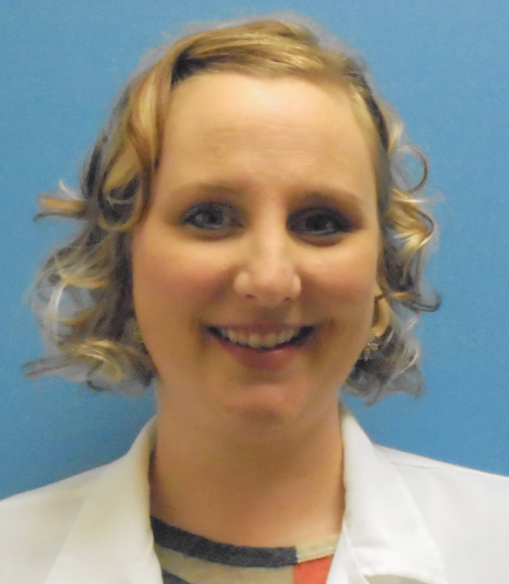
Elections- Sarah Schroeder
Elections Closed March 1
New election platform ElectionBuddy was fairly smooth
I have a few things I will change on the ballot for the next election
All Nominees have been notified of wins/losses
Voter Breakdown
76totalVotes
3 voters did not enter their AARC number so their votes were nulled
3votersenteredinvalid AARC numbers
1 voter’s membership expired 3/28 and they voted on 3/1 so vote was nulled
Total number of valid votes was 69
Positions with more than one nominee were extremely close so every vote does matter!
Notes:
Election updates given by Sarah Schroeder. See slide.

Slide 11
Elections- Sarah Schroeder
Election Results
President Elect-Theresa Meinen
Delegate Elect-Dustin Goodman
Secretary-Crystal Lockard (Ley)
District 2 Representative-Nick Goldberg
District 4 Representative-Shanna Schuele
District 6 Representative-PENDING Jeremy Perso
Jessica George & Sarah Bazelak are interested in any other opportunities to join the WSRC or NRRCC committees
Notes:
Election results reported by Sarah Schroeder. See slide. Will work with Franz to post results on AARC connect.

Slide 12
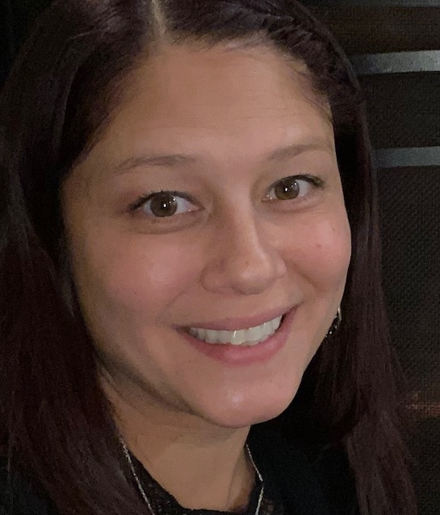
Education Co-Chairs Tara Managan & Christina Pano
Scholarship applications closed March 6th
BSRT
ASRT
Program
Notes:
Updates given by Franz Schuttenhelm.
We had one program apply and 2 people for the ASRT scholarship. Tara and I will be reviewing them and will continue to move forward with that process.

Slide 13
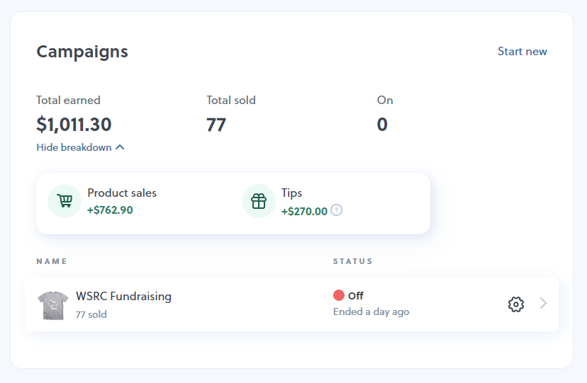
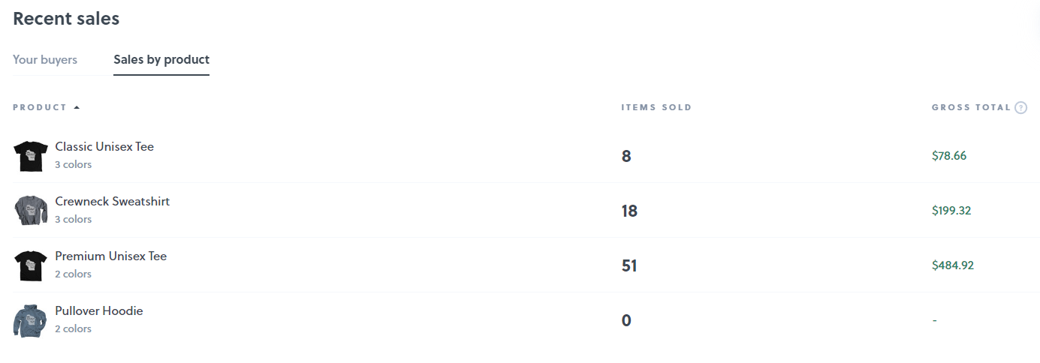
Fundraising committee Theresa, Jen, Megan, Laurel, Franz
Notes:
Updates given by Megan Ryba.

Slide 14
Fundraising committee Theresa, Jen, Megan, Laurel, Franz
Last meeting 2/1
Website advertising
New website realistically looking to launch near end of the summer.
Advertising prices to increase, with different tiers/spotlight areas, including social media.
Follow template with Michigan Society’s advertising contract.
Plan on 30 day auto-renewing contract.
Additional new website points
In-kind donation process. Perhaps something like the AARC “Wall of Donors”. Maybe using eventbright as a platform.
Creating a webstore with an assortment of different items. Working on how shipments and payments are made.
Other items:
Not much feedback from other state’s regarding fundraising.
Notes:
Updates by Franz Schuttenhelm. See slide.
Website update from Theresa Meinen: Josh will work on this after the NRRCC website.
Franz will send out a formal invite for ideas for the website from board members. Start thinking about what you might like to see on the website.

Slide 15
Fundraising committee Theresa, Jen, Megan, Laurel, Franz
Other items:
Not much feedback from other state’s regarding fundraising via AARConnect State Presidents.
Previously discussed:
Fundraising policies and creating a permanent committee with chair/co-chairs.
District rep policies and orientation guide adjusted to help with district level fundraising.
NRRCC items:
Notes:
Updates by Franz Schuttenhelm. See slide.

Slide 16
Onsite t-shirt making .
Notes:
Update on NRRCC items by Theresa Meinen: T-shirts will be made and sold onsite. Rachel Wagner’s brother will be providing this service with his small business. We are still working out the details with possible pre-ordering.

Slide 17
Front side-
#001
Thank you for supporting the WSRC scholarship in 2023!
Because of your sticker purchase, you will support our scholarships and the many opportunities related to them. To thank you, we will place your name into a gratitude drawing to show our appreciation for you support.
Drawing date: TBD (need not be present to win)
Drawing will be held at noon virtually live via social media.
Sticker purchase: 1 for $5.00 ?????? Multiple for discount?????
Each sticker purchase allows you one entry to our gratitude drawing.
Receipt #001
Name:
Address:
Phone:
Sell WSRC stickers and have a gratitude drawing for those that purchased a sticker.
Sticker purchases are minimal investment.
Sticker sales will pay for the Packer tickets. (approx. $129.00 a piece- total $258.00)
Back side-
Each sticker purchase allows you to be entered into a onetime drawing with the chance to win 2 tickets to a Green Bay Packers home game (Lambeau) during the 2023 season.
Game and date TBD once the NFL releases the schedules in May.
Wisconsin Society for Respiratory Care
P.O. Box 26005, Milwaukee, WI 53226
Notes:
Updates by Franz Schuttenhelm. See slide. Fundraising committee to keep working on further details.

Slide 18
Other reports, updates, and/or new business
President
Vice President
Treasurer
Past President
Legislative
Delegates
Membership Chairs
Districts
Military Liaison
NRRCC
Media relations
Facilities
Secretary

Slide 19
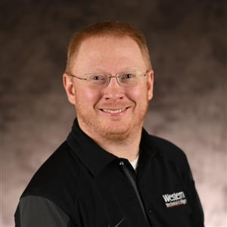
President- Franz Schuttenhelm
State of the Profession presentation to 70 RTs and RT students at the CVTC Respiratory Therapy Conference. Was able to ask…….“What do WI RTs want?”
Notes:
Updates given by Franz Schuttenhelm. See slide.

Slide 20
What do WI RTs want? CVTC responses
More money was the primary answer given by many.
Other answers:
Communication
Recognition
Support and Education
Respect
More responsibility
Better benefits
Larger scope of practice
Gratitude
Elevation of Profession
More autonomy
Notes:
Updates given by Franz Schuttenhelm. See slide.

Slide 21
President- Franz Schuttenhelm
Co-Marketing agreement with AARC
Timeframe | Chartered Affiliate Responsibility | AARC Responsibility
2023 Q1 | 3 Promotions of Summer Forum on social media and/or affiliate’s website Upload proof before April 14, 2023 Remain in Good Terms | Provide promotional materials for each quarter. Verify affiliates have met promotion requirements by date specified. Pay $250 to affiliates that qualified for quarter. Verify Affiliate is in Good Terms
Notes:
Updates given by Franz Schuttenhelm. See slide.
Franz will work with social media and membership committees to ensure we are meeting these responsibilities. If we show proof, we do get a quarterly $250.
Dustin Goodman is on a HOD committee with Speaker Jackson and is reviewing all societies website & marketing over the next quarter. Currently Wisconsin does not pass, but will re-evaluate with new website. Dustin will connect with Pia and Franz going forward. Dustin will send the criteria to Theresa to pass on to Josh to ensure website is built around the guidelines.

Slide 22
President- Franz Schuttenhelm
Other items:
Microsoft Business Basic Update
Moving forward with user ability
Guest access should equal paid access.
Please let me know if you require a username or PW
I’ll be reaching out to those with paid subscriptions to test some things.
Supporting Legislative team
Fundraising committee chair
Trying to support the membership committee ☺
Notes:
Updates by Franz Schuttenhelm. See slide.
Let Franz know if you require a user name or password. All access should be there.
Working on the orientation process and having it ready for the new group of incoming members.

Slide 23
Vice President- Ron Pasewald
WSRC District Rep Meeting orientation – planning date after announcement of WSRC election winners.
Legislative team: Supporting the legislative team, as needed by Chair.
Wisconsin School Counselor Association: No dates set for 2023. Sponsorship packages are $500-$5000 depending on commitment. Exhibit tables are $400-$500 (District Reps share cost?)
Planning local school career fairs. New Berlin School District. (Fall 2023)
MATC Milwaukee School visit – pending date with MATC faculty.
Planning Fall RT conference – One day conference – CRCEs. Venue set for Froedtert. Meeting with Director and Educator of Froedtert on 3/10 to continue planning.
Notes:
Updates by Ron Pasewald. See slide.

Slide 24
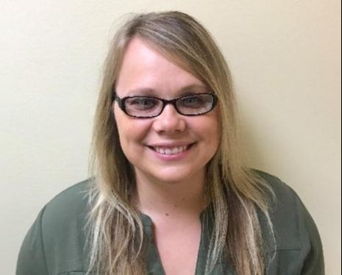
Treasurer Update- Laurel White
Checking Account:
Checking Account (Associated Bank) balance as of March 7, 2023 $48,554.49 (Minus NRRCC holdings)
Outstanding checks -$6,013.15
$42,541.34
Investments: As of March 7, 2023
Mutual Funds (Edward Jones) $ 101,670.16
Total Assets: $ 144,211.50
Notes:
Updates given by Laurel White. See slide.

Slide 25
Treasurer Updates
Investments increase by $496.15 since last meeting
Couple of standing expenses have increased
Microsoft Teams increased prices slightly $36 per month compared to previous $30 without any change to settings=$72 per year increase
P.O. Box $194 compared to previous $182 for 6mo=$24 per year increase
Busy processing and tracking NRRCC income/expenses
Participating in fund raising group and have started a spreadsheet to track all fund-raising income
Organizing 2022 Tax documents and have appointment to drop off
*I will not be physically present for the board meeting Crystal will present my slides on my behalf
Notes:
Updates given by Laurel White. See slide.
Investments seem more stable.
Bonfire fundraising amount will have about $36 in fees associated with a paypal fee before being able to transfer it to our checking account.
Laurel has started a fundraising tracking tool as it is only one budget line. This will allow for us to see what each fundraising effort brings in.
All incoming board members would benefit from meeting with the treasurer to discuss the budget, expense reports, etc. as part of the onboarding process.

Slide 26
Past President- Sarah Brundidge
Notes:
Updates given by Sarah Brundidge. Working to be a support person for the various committees.

Slide 27
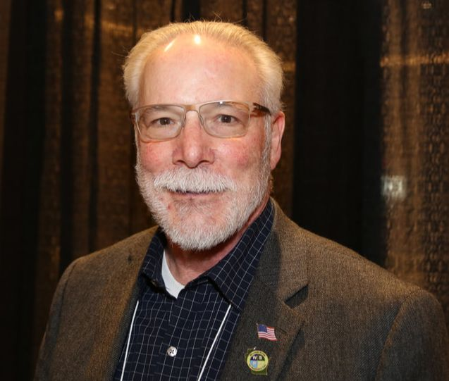
Legislative- Kris Ostrander & Dave Allain
Rep. Sortwell and Sen. Stafsholt have decided that they would like to roll out multiple regulations/licensing study committee bills out for co-sponsorship at the same time.
WSRC just waiting for the others to complete the final drafting phase.
WSRC support for Dan Hereth. Awaiting letter related to this support.
PACT meeting dates may change by a few days per AARC.
(Currently Sept 25-26)
Notes:
Updates by Kris Ostrander. See slide.
More to come on proposed legislation to remove the rules & statutes exams.
Dan Hereth is moving into the DSPS secretary role. We should support him in this role.
If you are interested in attending the PACT meeting dates, please let Kris know.

Slide 28
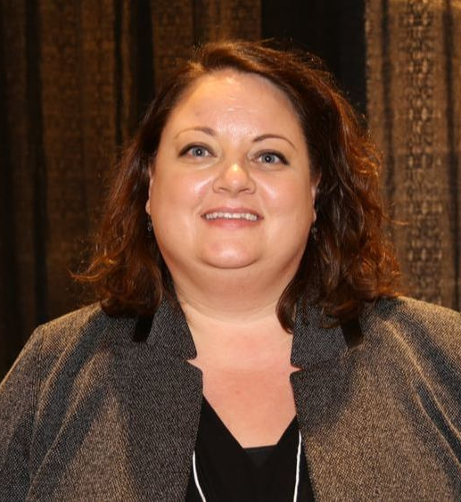
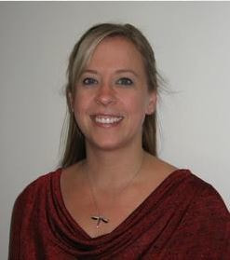
Delegate- Theresa Meinen Delegate Elect- Laura Packard
HOD virtual meeting rescheduled for 3/10/23 due to technical difficulties.
Delegate and Delegate transition to occur at NRRCC BOD meeting.
Notes:
Updates given by Theresa Meinen. See slide.

Slide 29
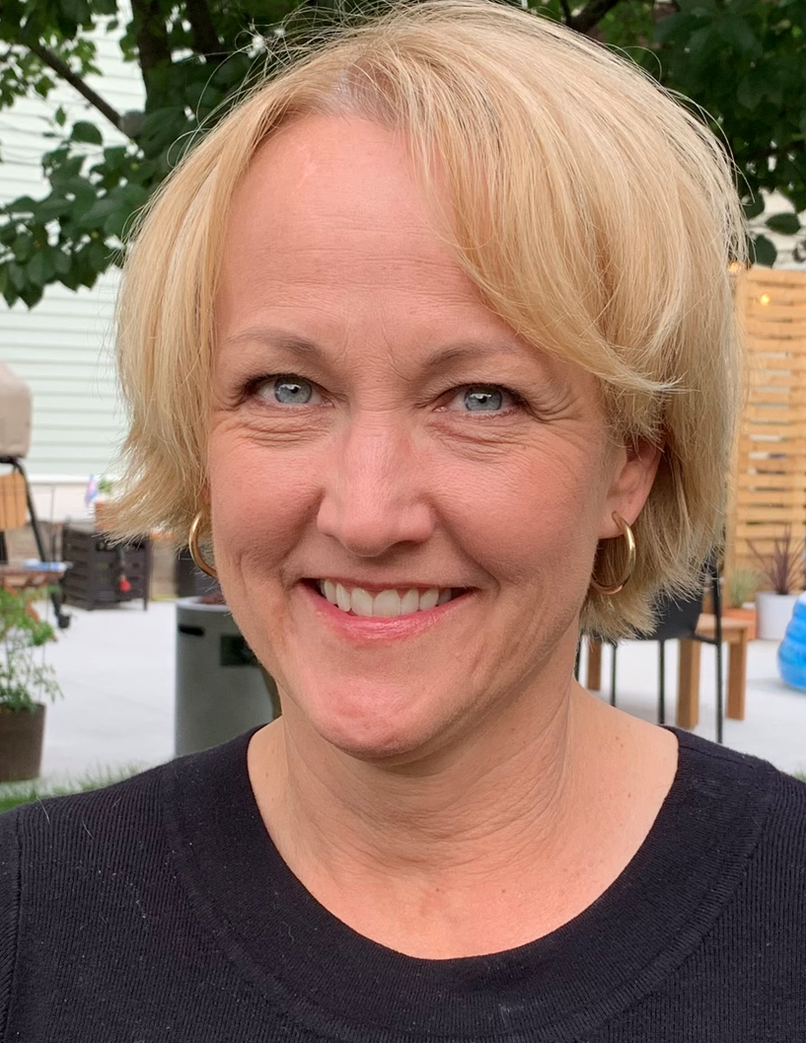
Membership- Kellianne Fleming & Amy Setchell
Notes:
Updates given by Kellianne Fleming. We have been trying to get contacts at other hospitals to work on a WSRC membership drive. Hoping to utilize the NRRCC as a kickoff for a membership drive and hope to give away a AARC membership. If other board members would like to connect to have conversations about boosting membership, please contact Kellianne. Franz is also speaking with past membership chair to get ideas for membership.

Slide 30
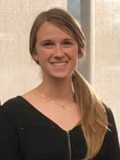
District 1- Megan Ryba
Counties of Douglas, Bayfield, Ashland, Burnette, Washburn, Sawyer, Polk, Barron, Rusk, St. Croix, Dunn, Chippewa, Pierce, Pepin and Eau Claire
Notes:
Updates by Megan Ryba. We did do the Feb 10th conference with CVTC. No other updates at this time

Slide 31
District 2- Taya Hass
Counties of Iron, Vilas, Price, Oneida, Lincoln, Langlade, Taylor, Marathon, Clark, Wood, Portage, Waupaca, Adams and Waushara
Notes:
Updates by Taya Hass. No updates. Taya will connect the new rep with Don Raymond (past district rep) and support as she can until she moves.

Slide 32
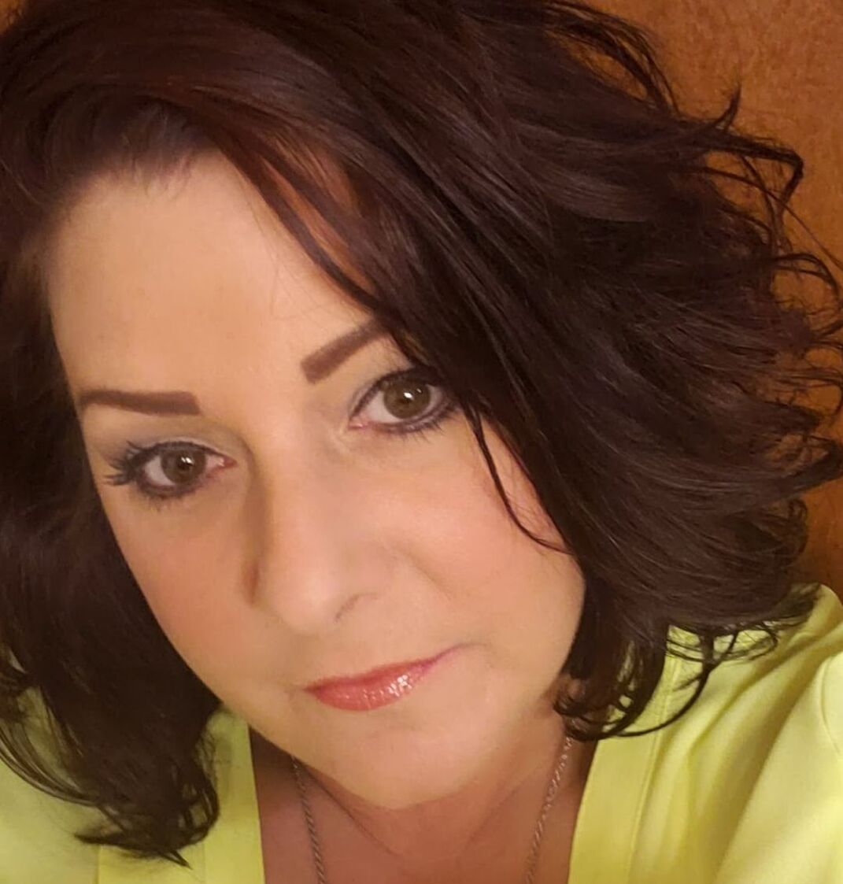
District 3- Angela Troxell
Counties of Forest, Florence, Marinette, Oconto, Menomonie, Shawano, Door, Outagamie, Brown, Kewaunee, Winnebago, Calumet, Manitowoc, Fond du Lac and Sheboygan
Notes:
No updates.

Slide 33
District 4- Benjamin Caldwell-Chadwick
Counties of Washington, Ozaukee, Waukesha, Milwaukee, Racine and Kenosha
Notes:
No updates.

Slide 34
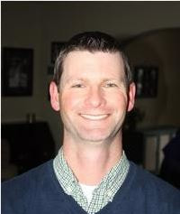
District 5- Joe Punzel Student liaison/understudy- Charlotte Kersten (Madison Technical College)
3/14/2023 – UW Health – WSRC Advancing Lung Strategies Conference
Educational opportunity and District fundraiser
Ongoing – Visit district High Schools for career fairs.
4 so far this semester in Dane, Rock, Jefferson and Dodge counties
Counties of Marquette, Green Lake, Sauk, Columbia, Dodge, Grant, Iowa, Dane, Jefferson, LaFayette, Green, Rock and Walworth
Notes:
Updates by Charlotte Kersten. See slide.

Slide 35
District 6- Open Position Student liaison/understudy- Leann Thao (Western Technical College)
Franz organizing a WSRC “chicken que” event for Monday, October 23rd (RC Week).
Western RT Club students will assist with ticket sales and help that day.
Donated meal purchases will be available, so that anyone/anywhere can purchase a ticket and the meal will be donated.
Counties of Buffalo, Jackson, Trempeleau, LaCrosse Monroe, Juneau, Vernon, Richland and Crawford.
Notes:
Updates given by Leann Thao and Franz Schuttenhelm. See slide.
Franz working on a todo list for how to run a fundraiser such as a chicken-que.

Slide 36
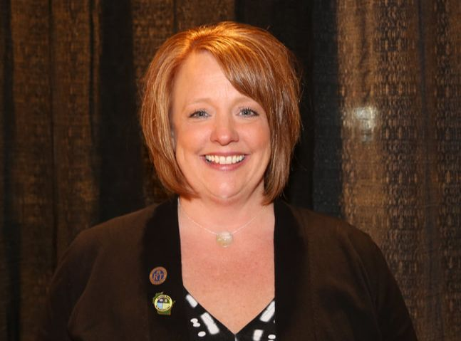
NRRCC- Jen Horkan
NRRCC planning is on track. As of our February meeting we had 58 registered students and 107 registered practitioners.
We will have live streaming for those who live 300 or more miles away. This will be in one room, see the NRRCC website for details.
If you know of any veterans and would like to submit a photo of them to be added to our video that will be run on Sunday night. Please let me know and I will get it submitted. Please attach the veterans name as well as the name of the person submitting the video.
We also would like to invite any retired RT’s to our Monday night entertainment night. Please send me names and email address of anyone you would like invited. The them is reunion so people should come dressed as they would the year the graduated from RT school or high school.
We do have one speaker spot to fill.
The BOD meeting is scheduled for 430 pm on Sunday April 30th at the Wilderness.
Student activity will be Monday instead of Tuesday and will be done in the exhibitor hall.
We are seeing some exhibitors who are unable to come due to budgetary restrictions.
Notes:
Updates by Theresa Meinen. See slide.
If you have not liked the NRRCC on all social platforms, please do so. Share and invite as well. Thanks!

Slide 37
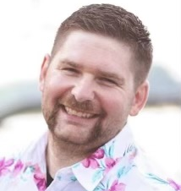
Military Liaison- Jarrett Brandes Dave Allain-onboarding Jarrett
Military grant posted
$250.00 to a WI individual
$250.00 to a MN individual (determined by the MSRC military liaison, Joshua Oye)
Several WI applicants already received.
End March 31^{st.}
Will notify Jen and other appropriate people on April 1st
We have 3 military individuals (Madison students) already committed to the color guard ceremony. Jarrett and Joshua will also be participating for a total of 5.
Still looking for at least 3 more military volunteers.
Tentative- Dave Allain will MC the ceremony.
NRRCC registration committee is aware to notify Jarrett with military members attending.
Notes:
Updates by Franz Schuttenhelm. See slide. Military grant posted on AARC connect.

Slide 38
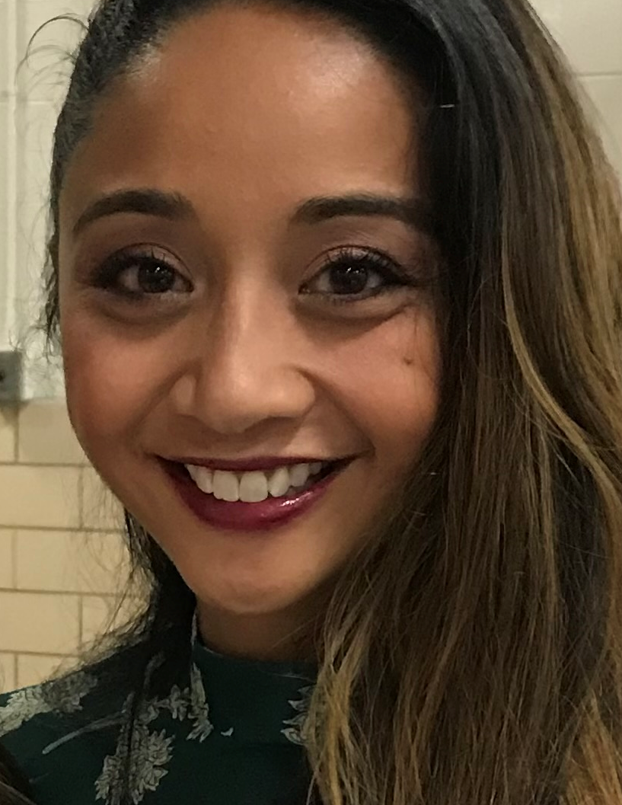
Media Relations- Pia McEleney Sarah B. –onboarding Pia
Dustin Goodman and Kirsten Holbrook joining Pia as committee members. Pia will be sole chair and have Dustin and Kirsten help as needed.
Expectations for early 2023
Expand our presence to all available platforms.
Create a posting calendar/guide to help organize what needs to be added and when. …
In addition to the calendar/guide. Help create a process for how BOD members want things shared. Set rules and regulations for submission.
Poll and/or create dialogue in order to open our social media channels up to more people.
Notes:
Updates given by Franz Schuttenhelm. See slide.

Slide 39
Facilities- Laura Packard
Notes:
No updates.

Slide 40
AARC Secretary House of Delegates- Jodi Jaeger
Notes:
No updates.

Slide 41
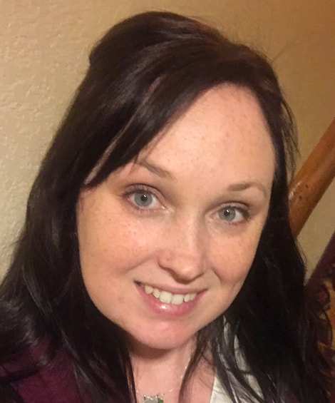
Secretary- Crystal Ley
Fill out and email reports for those who have not sent/completed them prior to the meeting
Notes:
If you did not send reports prior, please send them to be included in the minutes.

Slide 42
Other Committee Reports or business to discuss?
New Business Discussed and not completed?
Notes:
No new topics.

Slide 43
Open mic/conversations with guests.
Notes:
None in attendance.

Slide 44
Next Meetings
April 30th (Sunday) at the NRRCC 1600
(Wilderness 1 conference room)
June 27 1630-1800 (Tuesday)
August 22 1630-1800 (Tuesday)
Early October to coincide with WSRC retreat (dates TBD)
December 12 1630-1800 (Tuesday)
March 5 1630-1800 (Tuesday)
NRRCC 2024 (TBD)

Slide 45
Adjournment
Motion?
2nd the motion?
All in favor?
All opposed?
Notes:
Theresa Meinen made a motion to adjourn
Taya Hass 2nd
Motion passed
Adjourned at 5:54pm

