Slide 1
Wisconsin Society for Respiratory Care Board Meeting
NRRCC Board Meeting- April 30, 2023
OUTGOING

Slide 2
Welcome to the guests attending today!

Slide 3
Roll Call- Quorum
ARTICLE X - BOARD MEETINGS
A meeting of the Board of Directors may be called by the President or the majority of the voting membership of the board.
A majority of voting board members must be present to constitute a quorum. (13 voting members= require 7 for a quorum)
Notes:
Quorum met at 4:34pm

Slide 4
Call to Order-
Notes:
Call to order ***

Slide 5
Approve new board members
President Elect- Theresa Meinen
Secretary- Crystal Lockard
Delegate Elect- Dustin Goodman
District 2 Representative- Nick Goldberg
District 4 Representative- Shanna Schuele
Notes:
Motion to approve board members by Taya Hass
Seconded by Joe Punzel
Motion passed

Slide 6
Adjournment
Motion?
2nd the motion?
All in favor?
All opposed?
Notes:
Franz Schuttenhelm made a motion to adjourn
Theresa Meinen 2nd
Motion passed
Adjourned at 4:35pm

Slide 7
Wisconsin Society for Respiratory Care Board Meeting
NRRCC Board Meeting- April 30, 2023
INCOMING

Slide 8
Roll Call- Quorum
ARTICLE X - BOARD MEETINGS
A meeting of the Board of Directors may be called by the President or the majority of the voting membership of the board.
A majority of voting board members must be present to constitute a quorum. (13 voting members= require 7 for a quorum)
Notes:
Quorum met at 4:35pm

Slide 9
Call to Order-

Slide 10
Appointed Chairs for this term
New
Taya Haas, Media Relations (Co-Chair)
Sarah Bazelak, Legislative (Co-Chair)
Notes:
Theresa Meinen Made a motion to approve the appointed chairs for this term
Seconded by Dustin Goodman
Motion passed

Slide 11
A moment for hyperoxygenation…..

Slide 12
Minutes-
Previous Minutes reviewed and approved?
Motion?
2nd the motion?
All in favor?
All opposed?
Notes:
Theresa Meinen made a motion to approve the minutes.
2nd by Laura Packard
Motion passed

Slide 13
Old Business
Updated policies (Brett and Franz)
Fundraising committee update (Megan, Jen, Laurel, Theresa, and Franz)
Notes:
Brett: Shared policies earlier today through email. Policy on Regulatory committee are being completed by Legislative committee. Please take a look at this to see if we think we could retire this.
Fall retreat will be a good place to review policies on a regular basis.
Fundraising Update: The t-shirt booth is here during the exhibitor hall tomorrow that will be giving $5 of each t-shirt donating back to the WSRC. Payment will be through a link.
We are looking at policies and working with Brett to make this a permanent committee to help with fundraising efforts in the future.
We will be supporting the district reps.
Packer ticket drive – donation receipts. A pack of 20 will be given to each board member. With every donation, make sure we give them a sticker.

Slide 14
Policy & Bylaws- Brett Buenzli
Policy revisions.
Policy procedure manual
Education Scholarships
Delegates
B&A committee
District Representatives
Facilities
Regulatory

Slide 15
Fundraising committee Theresa, Jen, Megan, Laurel, Franz
NRRCC t-shirt booth
Working on Policies to roll out a permanent fundraising committee for the WSRC.
Supporting District Representatives with district fundraising efforts.
Donations for Packer tickets kicking off at the NRRCC.

Slide 16
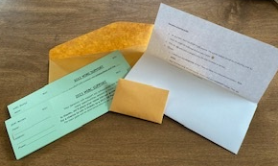
Fundraising committee Theresa, Jen, Megan, Laurel, Franz

Slide 17
Other reports, updates, and/or new business
President
Vice President
President-Elect
Treasurer
Legislative
Delegates
Facilities
Education
Elections
Membership Chairs
Districts
Military Liaison
NRRCC
Media relations
AARC Jodi J.
Secretary

Slide 18
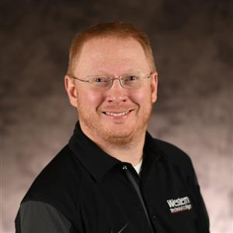
President- Franz Schuttenhelm
Testimonial hearing in Madison. Awaiting next steps.
Arranging donation drawing material.
Microsoft Business Basic Progress
Supporting Legislative team
Fundraising committee chair
Arranging RT recruitment events for the fall
D6 representative
Notes:
Updates given by Franz Schuttenhelm. See slide above.

Slide 19
Vice President- Ron Pasewald
Assisted Tara, Franz and District Rep team in orientation process. Joe Punzel has completed his “orientation video” and uploaded it to the Teams Drive. Angela Troxell is in process of completing her video.
Working with Sarah Bazelak and Kellianne Fleming on a Fall RT CRCE Symposium. Venue set. Date pending. Recruiting speakers and then submitting to the AARC by June/July.
Assisting legislation team with Ethics Exam bill.
Have multiple HighSchool Career Fairs scheduled for RT student recruitment: New Berlin, Mukwonago and Muskego. Set for the Fall.
Notes:
Updates given by Franz Schuttenhelm in Ron Pasewald’s absence. See slide above.

Slide 20
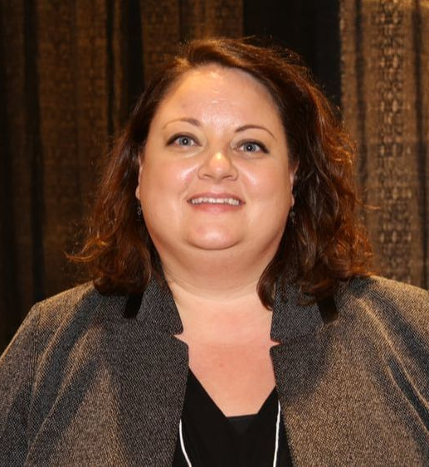
President Elect- Theresa Meinen
Chair the B&A Committee
Continue to assist Fundraising committee and assist creation of this being a permanent committee w/ bylaw specific items.
Help lead the new website creation.
Notes:
Updates given by Theresa Meinen. See slide.
As soon as NRRCC finishes up, the web designer will now be working on our WSRC website. Per the AARC, our website does not meet their guidelines. We have given him the guidelines and will build it to their expectations. If you have ideas that should be on our new website, please let Theresa or Franz know.

Slide 21
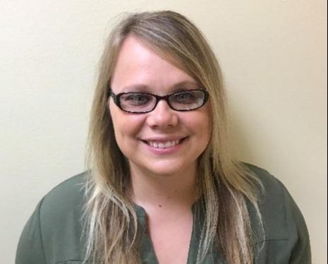
Treasurer Update- Laurel White
Checking Account:
Checking Account (Associated Bank) balance as of March 7, 2023 $43,441.73 (Minus NRRCC holdings)
Outstanding checks -$7069.23
$36102.57
Investments: As of March 7, 2023
Mutual Funds (Edward Jones) $ 10,1970.31
Total Assets: $ 13,8072.88
Notes:
Updates given by Laurel White. See slide.
Laurel has reached out to the AARC in regard to the revenue sharing- we would like clarification on amounts rewarded.

Slide 22
Treasurer Update- Laurel White
Investments increase by $*** since last meeting
Busy processing and tracking NRRCC income/expenses
Participating in fund raising group and have started a spreadsheet to track all fund-raising income
Organizing 2022 Tax documents and have appointment to drop off
WI state Tax-exempt status has changed due to a law. We are a 501(c) 6 and not a 501(c)3
NRRCC/WSRC reimbursement forms are available if you need them.

Slide 23
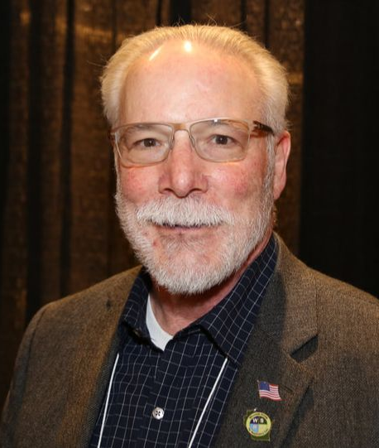
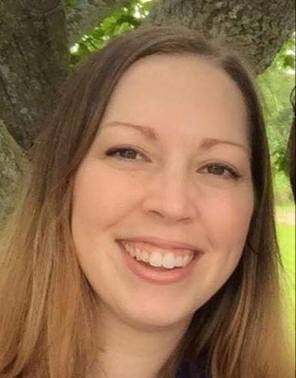
Legislative- Kris Ostrander, Dave Allain, & Sarah Bazelak
Assembly Bill 143 and Senate Bill 160
Request removal of Rules and Statutes Exam for RCP licensure.
Includes OT, OTA, RPH, APN, and LPC licenses.
AB143 heard before Assembly Committee on Licensing Reform
Anticipate SB160 review by Senate Committee on Licensing, Constitution and Federalism in May
Key concern from democratic leaders is that is will lower the WI standards for RCP licensing and impact safety.
Notes:
Updates given by Kris Ostrander. See slide.
Welcome to Sarah Bazelak who will be working with the legislative committee.
We are working with the lobbyist- current project is the rules and statues exam. The process is quite lengthy, and we are urging new grads to get this completed as soon as possible. Exam process will be through email, rather than electronic. This can take two weeks to 3 months or longer.
Franz is helping with the hearings. 143 hearing was just completed. These bills request the DSPS to not require the RT practitioner to remove the rules & statues exam. This would expediate things, as well as reduce fees by $75.
We anticipate 160 will go to hearing in May. Hoping to have a bipartisan bill passed by working through the democratic side.

Slide 24
Legislative- Kris Ostrander, Dave Allain, & Sarah Bazelak
AB144 and SB 158
DSPS must grant a preliminary credential to an individual who attests to meeting all of the requirements for a corresponding permanent or training credential, including having completed all education, training supervised experience, and similar requirements within the previous two-year period.
Must have an employer and no disqualifying convictions.
Applicant must also apply for a permanent license.
SB221
Allows RCP to fill a required ambulance staffing position when the ambulance is an aircraft.
Notes:
Updates by Kris Ostrander.
Bills 144 and 158 were stumbled on upon looking at the other bills. Very much like the Covid process.
Bill 221 – this would allow for a RCP to be the second ambulance crew member in a helicopter.

Slide 25
Legislative- Kris Ostrander, Dave Allain, & Sarah Bazelak
PACT Days- Washington D.C.
September 25-26, 2023
Hilton Hotel
Sarah Bazelak and Dustin Goodman representing WSRC.
Notes:
Updates given by Dave Allain.
PACT days used to be in spring, however now are in fall.
Dave will help with succession planning of PACT. The group with get together and make a plan for going forward.

Slide 26
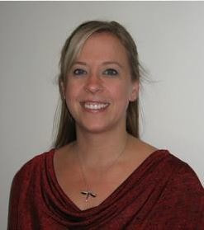
Delegate- Laura Packard Delegate Elect- Dustin Goodman
WSRC Bylaws are due for review by Feb 2024 (submit by Jan). Review at Fall Retreat?
AARC Sputum Bowl is back!
VA in Washington approved the 1st APRT position!
Thank you for your mentoring, Theresa – welcome Delegate Elect Dustin!
Notes:
Updates given by Laura Packard. See slide.
Fall retreat would be a good place to have the policies reviewed as well as the bylaws.
Dustin: Sit on the AARC CAC and will help with the website to help us receive full funding with revenue sharing.

Slide 27
Facilities- Laura Packard
Fall Retreat update
Location determined at last retreat – Next is in La Crosse
Dates: Monday October 2 – Tuesday October 3
Monday – Half workday with Dinner and Team Building Event to follow.
Tuesday – Full workday with Breakfast and Lunch at meeting.
Potential Casual Dinner? District Event? Meet the Board Social?
Wednesday - Safe Travels
Notes:
Updates given by Laura Packard. See slide.
Laura will send a calendar invite for October 2nd and 3rd, 2023 for the fall retreat.

Slide 28
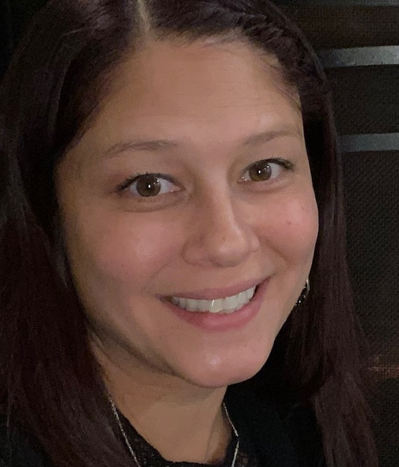
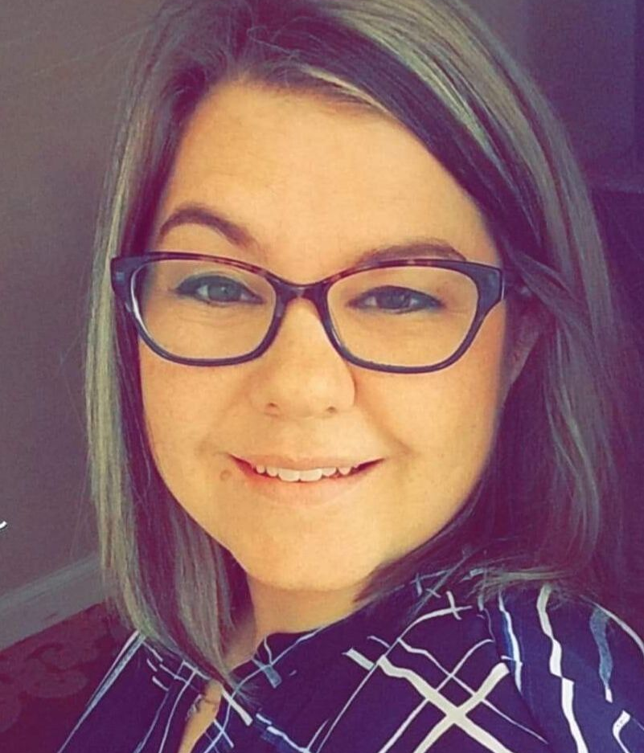
Education Co-Chairs Tara Managan & Christina Pano
Scholarship being awards tonight.
Arranged meeting with WI program instructors.
Taking place Monday at 5
Notes:
Updates given by Christina Pano and Tara Managan. See slide.
Scholarship applications received were low. No bachelor’s program applicants. Some concerns with students regarding volunteer time and will investigate this. If you have any questions or suggestions to please let the education co-chairs know. We would like more applicants.

Slide 29
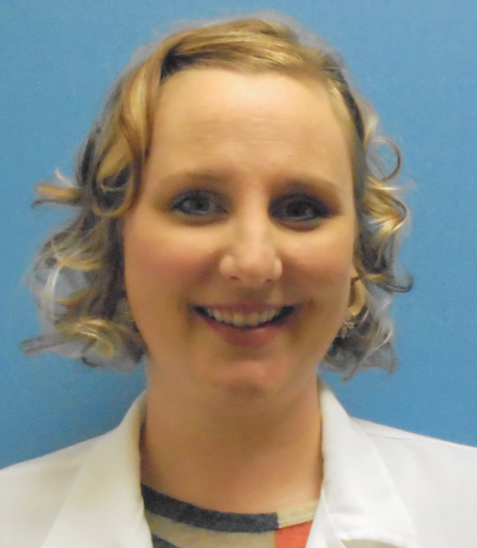
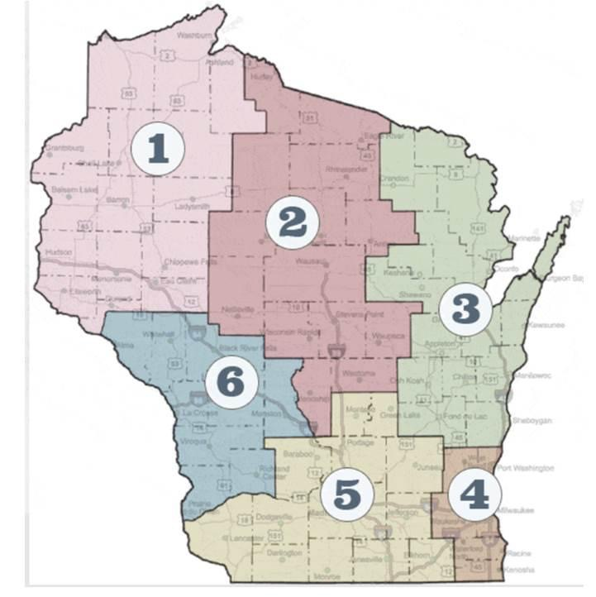
Elections- Sarah Schroeder
District 6 remains vacant.
Notes:
Update by Sarah Schroeder. See slide. If anyone if interested in District 6, let a board member know. Leann Thao remains a district 6 student rep/understudy. Rachel will do some outreach.

Slide 30
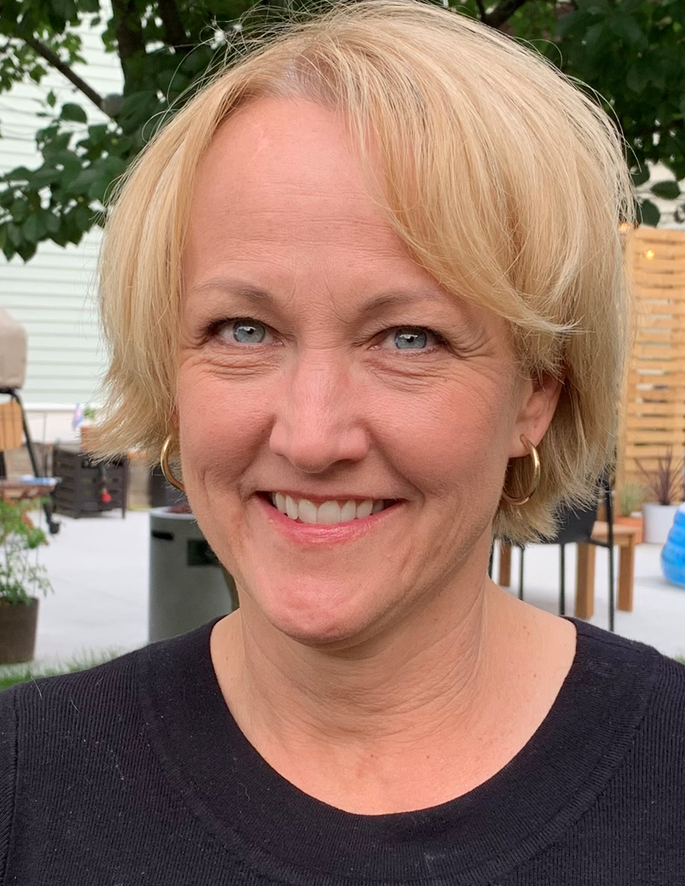
Membership- Kellianne Fleming & Amy Setchell
Gathering membership information via the WSRC booth
Making contact with WI managers to work with them regarding membership improvement statewide.
Notes:
Updates given by Amy Setchell. See slide.
Heather Wilton is now the membership contact at AARC.
Around 760 active members, around 570 are active practitioners, and around180 are students/military/seniors.
Would like to connect with social media to work on membership drives and promotions.

Slide 31
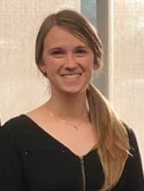
District 1- Megan Ryba
No events for 2nd quarter aside from the NRRCC.
Goals for 3rd quarter:
Make contact with district 1 hospital, clinic and dme RT’s
start organizing chicken que fundraiser for district 1
plan 1-2 social events for district 1 for summer
Counties of Douglas, Bayfield, Ashland, Burnette, Washburn, Sawyer, Polk, Barron, Rusk, St. Croix, Dunn, Chippewa, Pierce, Pepin and Eau Claire
Notes:
Updates given by Megan Ryba. See slide.
Chicken que- chicken bar-b-que fundraiser (popular on west side of state)

Slide 32
District 2- Nick Goldberg
Counties of Iron, Vilas, Price, Oneida, Lincoln, Langlade, Taylor, Marathon, Clark, Wood, Portage, Waupaca, Adams and Waushara
Notes:
Welcome Nick!

Slide 33
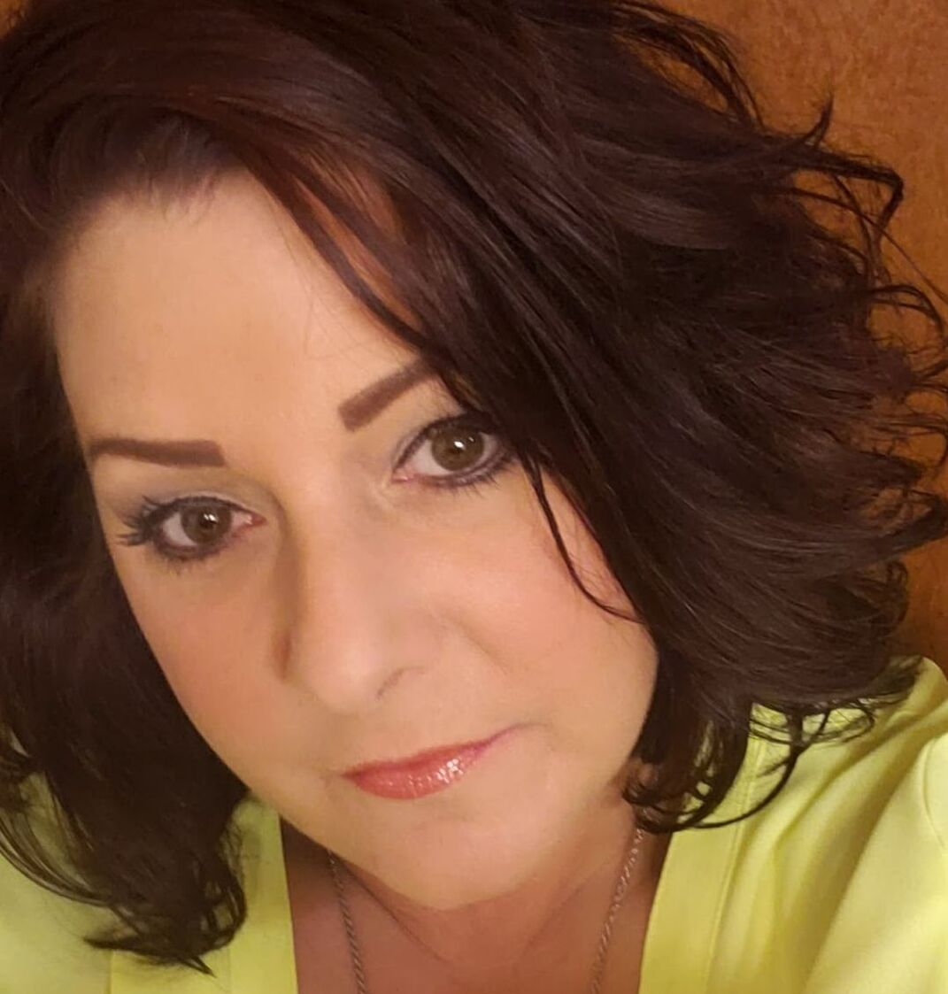
District 3- Angela Troxell
Counties of Forest, Florence, Marinette, Oconto, Menomonie, Shawano, Door, Outagamie, Brown, Kewaunee, Winnebago, Calumet, Manitowoc, Fond du Lac and Sheboygan
Notes:
Absent- no updates reported.

Slide 34
District 4- Shanna Schuele
Counties of Washington, Ozaukee, Waukesha, Milwaukee, Racine and Kenosha
Notes:
Welcome Shanna!

Slide 35
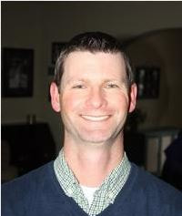
District 5- Joe Punzel Student liaison/understudy- Charlotte Kersten (Madison Technical College)
3/14/2023 – UW Health – WSRC Advancing Lung Strategies Conference
Educational opportunity and District fundraiser
30 in attendance
Will become yearly event
Ongoing – Visit district High Schools for career fairs.
2 so far this semester in Dane county
Counties of Marquette, Green Lake, Sauk, Columbia, Dodge, Grant, Iowa, Dane, Jefferson, LaFayette, Green, Rock and Walworth
Notes:
Updates given by Joe Punzel. See slide.
$575 raised in Advancing Lung Strategies Conference.

Slide 36
District 6- Open Position Student liaison/understudy- Leann Thao (Western Technical College)
Arranging a volunteer event for the summer quarter.
Franz organizing a WSRC “chicken que” event for RC Week
Western RT Club students will assist with ticket sales and help that day.
Donated meal purchases will be available, so that anyone/anywhere can purchase a ticket and the meal will be donated.
Counties of Buffalo, Jackson, Trempeleau, LaCrosse Monroe, Juneau, Vernon, Richland and Crawford.
Notes:
Updates given by Franz Schuttenhelm. See slide.

Slide 37
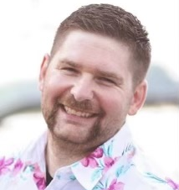
Military Liaison- Jarrett Brandes
Military grants awarded tonight.
Color guard and presentation of colors tonight.
Notes:
Updates given by Jerrett Brandes. See slide.

Slide 38
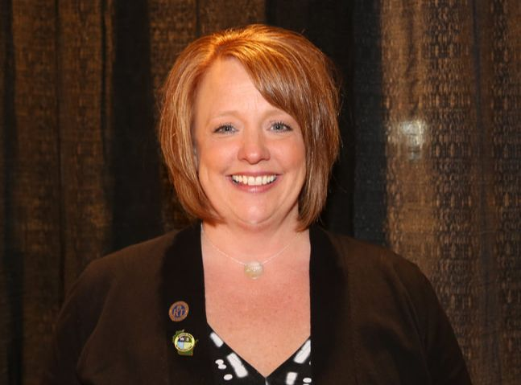
NRRCC- Jen Horkan
Another successful NRRCC is kicking off!
Notes:
Updates given by Jen Horkan. We are signing our MN/WI state contract on the odd years. We will also need to decide how long we want to continue to host the NRRCC in a joint venture with the NRRCC.

Slide 39
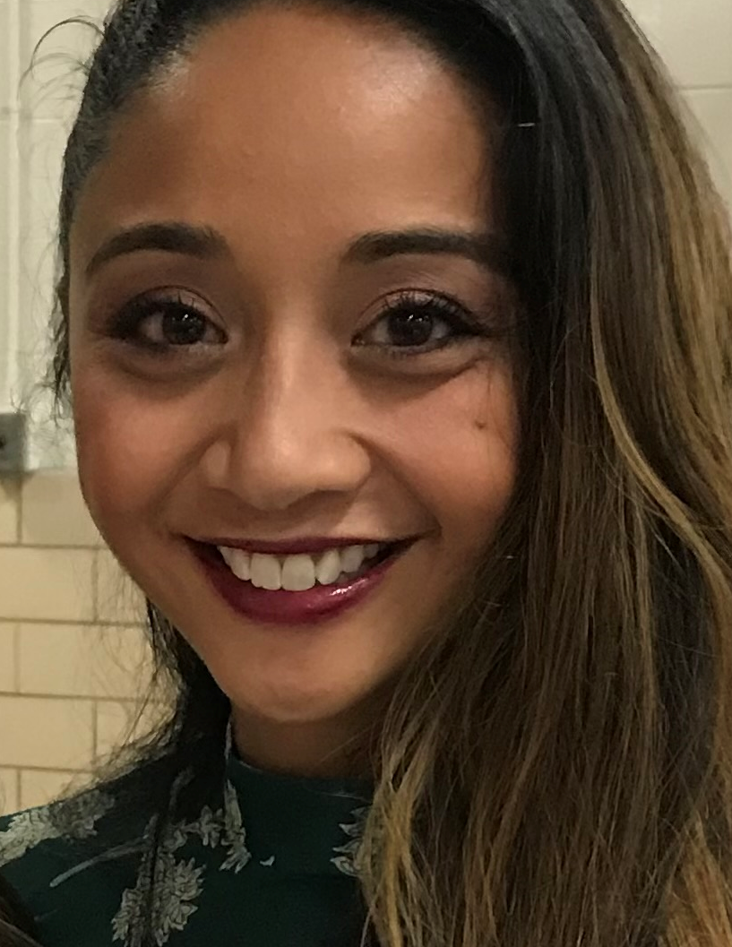
Media Relations- Pia McEleney & Taya Haas
Notes:
Updates given by Taya Haas. We have 970 likes on FB- goal is 1,000. Would like to expand our social media platform to tik-tok, etc.

Slide 40
AARC Secretary House of Delegates- Jodi Jaeger
Notes:
Updates given by Jodi Jaeger.
Director at large now with the AARC. There have been a large amount of staff turnovers at AARC. Heather Willdon will be supporting the affiliates and will be your contact.
Spring board meeting had DEI meeting. Membership has started to climb since Covid. Working on strategic goals and measures.
Social media NBRC be an RT, please share!

Slide 41
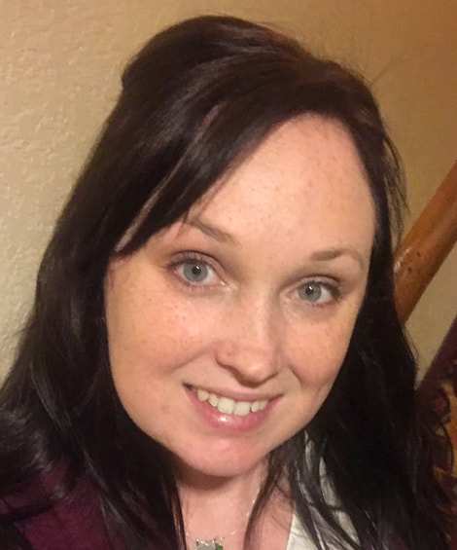
Secretary- Crystal Ley
Fill out and email reports for those who have not sent/completed them prior to the meeting
Notes:
If you did not send reports prior, please send them to be included in the minutes.

Slide 42
Other Committee Reports or business to discuss?
New Business Discussed and not completed?
Notes:
We are sad to see Cardinal Stritch closing.
Madison College revised their clinical preceptor shadow program.
Kellianne working with Rush to work on a Respiratory Master’s program.
Ron Pasewald is working on registering for the Nov 1-3rd conference at Kalahari and registration is open for WI Guidance Councilor's association conference.

Slide 43
Open mic/conversations with guests.
Notes:
None in attendance.

Slide 44
Next Meetings
June 27 1630-1800 (Tuesday)
August 22 1630-1800 (Tuesday)
Early October to coincide with WSRC retreat (dates TBD)
December 12 1630-1800 (Tuesday)
March 5 1630-1800 (Tuesday)
NRRCC 2024 (TBD)
Notes:
NRRCC is April 22-24, 2024

Slide 45
Adjournment
Motion?
2nd the motion?
All in favor?
All opposed?
Notes:
Dustin Goodman made a motion to adjourn
Theresa Meinen 2nd
Motion passed
Adjourned at 5:48pm

