Slide 1
Wisconsin Society for Respiratory Care Board Meeting
August 22, 2023

Slide 2
Roll Call- Quorum
ARTICLE X - BOARD MEETINGS
A meeting of the Board of Directors may be called by the President or the majority of the voting membership of the board.
A majority of voting board members must be present to constitute a quorum. (13 voting members= require 7 for a quorum)
Attendance report 8-22-23
Notes:
Quorum met at 4:32

Slide 3
Call to Order-
Notes:
Call to order 4:32pm

Slide 4
A moment for hyperoxygenation…..
AARC Leadership Bootcamp 2023
Keynote speaker: Jann Freed, PhD Leading with Wisdom
Leadership is not a position or title.
It is a relationship.
Leader: Person in a position to influence the lives of other.
The key question to ask.
What are 1 or 2 things that I can do to support you?
Notes:
Leadership bootcamp last week. Key takeaways shared by Franz Schuttenhelm.

Slide 5
Minutes-
Previous Minutes reviewed and approved?
Motion?
2nd the motion?
All in favor?
All opposed?
Notes:
Dustin Goodman made a motion to approve the minutes.
Second by Joe Punzel
Motion passed

Slide 6
Old Business
ITEM | OWNER | TARGET DATE | STATUS
Guidance counselor conference registration, etc. | Franz Schuttenhelm & Theresa Meinen | See attachment related. | In progress
Submit website ideas to Theresa Meinen | All | See attachment related. | In progress
Create concrete district rep policies regarding events | District Reps & Education Chairs | Theresa will help take lead as necessary. | In progress
Transition remaining Google Drive documents to Teams/SharePoint | Theresa Meinen, Crystal Lockard & Dustin Goodman | Continuing and update at next meeting. | In progress
Obtain Social Media Guidelines from AARC Revenue sharing agreement. | Franz Schuttenhelm & Taya Haas | Update at next meeting. | Awaiting AARC response
Edit District Event Survey | Shana Schuele | Update at next meeting. | COMPLETED and UPDATE w/ SLIDE
Distribute District Event survey when updated | All | Update at next meeting. | COMPLETED and UPDATE w/ SLIDE
Take questions to HOD about resolutions 2 & 3 | Dustin Goodman & Laura Packard | Summer Forum | COMPLETED and UPDATE w/ SLIDE
Revenue sharing and Co-Marketing Agreements with AARC | Franz Schuttenhelm and Taya Haas w/ assistance from delegates as needed. | Q3 | In progress
Notes:
Website ideas were sent to Theresa District Rep Event – District reps and Theresa have not yet met yet.
Continuing to work on district rep policies.
Social Media- Reached out to AARC to ask what we can post re: CRCE/CEUs. We are awaiting a response.
District surveys are out and awaiting completion
Resolutions- update to be shared later in meeting by our delegates
Revenue sharing- Franz Schuttenhelm will review for Q2

Slide 7
WSCA conference
Wednesday, Thursday, Friday
November 1st through 3rd, 2023
Kalahari, WI Dells
Only received some interest from Tara and Megan.
Is anyone able to commit to this?
Notes:
WSCA Conference: Guidance counselor registration- no interest in attending from any board member. Registration is now closed. Overlaps AARC congress.
Megan Ryba can try to switch days at work to try to attend
Franz Schuttenhelm will reach out to find out more information on if we can still get into the exhibitor hall

Slide 8
Fundraising Committee Packer donation gratitude drawing
648 $5.00 donations accounted for.
648 x 5 = 3240.00
Actual amount was 3311.50.
Larger amount due to a last-minute donation that didn’t have tickets tied to and also some extra donations not equaling $5.00
Expenses:
Paypal fees- 65.78
Stubs (printing fee for 600)- 136.50
Stickers (before we changed it to donation vs. exchange of goods)- 120.9
Tickets- 135x2= 270
Total deductions= 593.18
FINAL FUNDRAISED AMOUNT= 3311.50-593.18= $2718.32
Notes:
Packer Drawing- Thank you! We raised $2718.32

Slide 9
More of a breakdown
24 board members received 20 stubs/receipts
Collected # donations (5.00 each)
Final collection
40 or more= 4
20 to 39= 1
20 = 16
Less than 20= 1
Less than 10= 1
None = 1
Fundraising committee will meet in September to plan our next items.
RC week related?
Additionally, we’ll help push forward with new-website advertising sales.

Slide 10
New Business in addition to upcoming reports

Slide 11
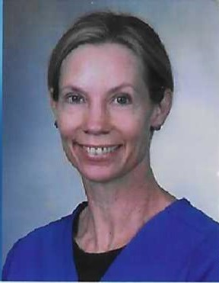
We’ve got somebody for District 6!!!!
May we have a motion/vote for Melody Kloepfer!
WELCOME TO MELODY!!!!
WE’RE EXCITED AND GRATEFUL TO HAVE YOU JOIN US!!!!
Notes:
District 6 Filled- Welcome Melody!
Laura Packard made a motion
Seconded by Laurel White
Motion passed to approve Melody Kloepfer as the district 6 rep.

Slide 12
Other reports, updates, and/or new business
Education
President
Vice President
President-Elect
Treasurer
Legislative
Delegates
Facilities
Membership Chairs
Districts
Media Relations
NRRCC
Elections
Military Liaison
AARC Jodi J.
Secretary

Slide 13
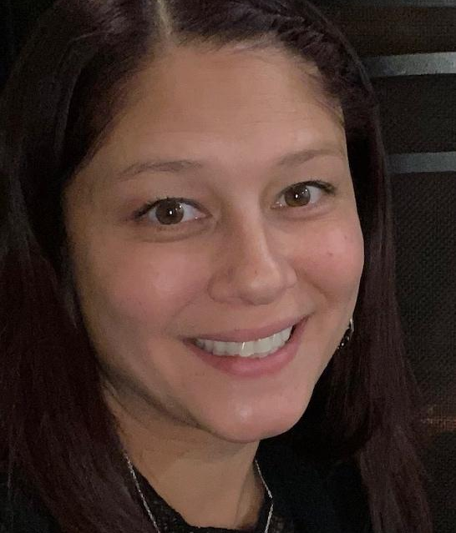
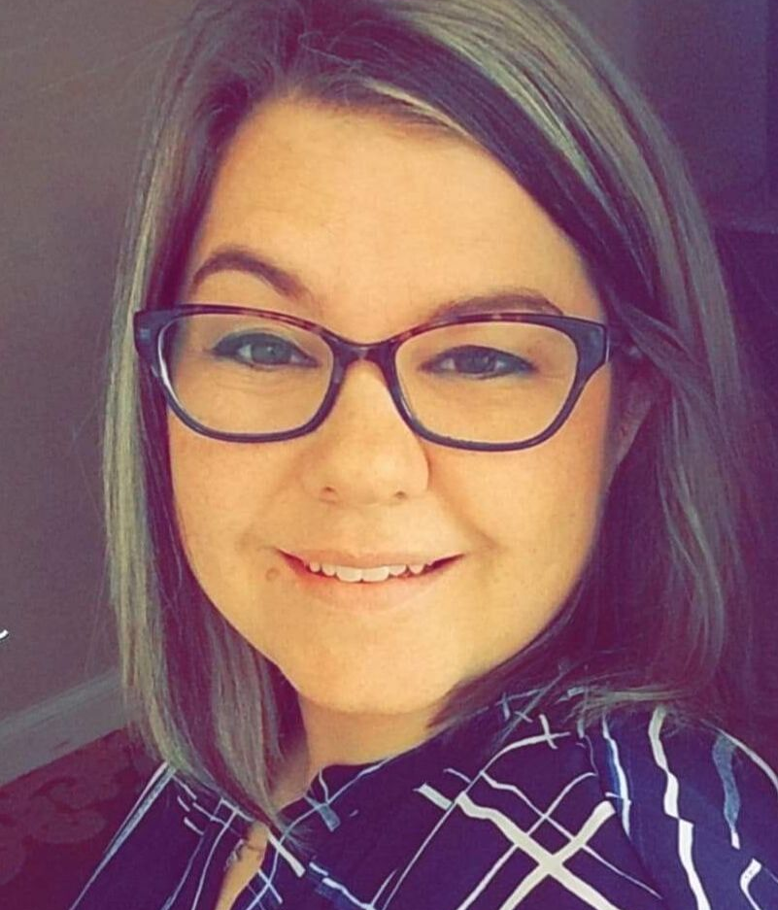
Education Co-Chairs Tara Managan & Christina Pano
Review both policy and scholarship for 2024 Award Year
Policy Update
Added verbiage to allow for 2 student awardees if no applications for Bachelor Degree Scholarship
Dates on scholarships updated to reflect the 2024 award
3/4/24 Applications due to WSRC Edu Co-Chairs
3/31/24 Award Announcement
4/21/24 Award Issue at NRRCC
Notes:
Education: Updates as shown on slide. We will be reaching out to the schools during RT week to promote the scholarships. Scholarships open in January. Dustin Goodman- do we open this during RC week so they can apply right away? We have opened it earlier, but we could open it even earlier if we think this is a good idea.
Shanna Schuele- Is there a Masters scholarship? We do not currently have a Master’s scholarship, only associate and bachelor’s.
Melody Kloepfer- bring to directors at teaching hospitals to pass along the opportunity as well.
Vote to add verbiage to scholarship policy.
Motion made by Dustin Goodman
Second by Shanna Schuele
Motion passed.

Slide 14
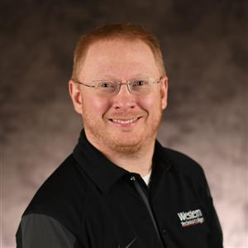
President- Franz Schuttenhelm
Supporting Legislative Team-
Collecting statutes exam related requirements from all states.
Meet with Gov. Ever’s team in next couple of months.
Fundraising Chair-
Completion of Packer donation drawing.
President’s panel at AARC Leadership Bootcamp
Newsletter- Any other ideas for where to share?
Arranging retreat speakers and agenda with Laura and Theresa.
Revenue Sharing and Co-Marketing agreements amendment signed and Q2 money received.
Meeting with District Reps to present collection of onboarding items.
Working with Theresa on yearly “to do list” calendar for Presidents. This should also be able to expand to all board members.
Assisting Theresa with the new website.
District Representative and New Board Member orientation guides- via Teams
Notes:
Updates shown on slide shared by Franz Schuttenhelm.
Regarding Newsletter and AARC connect- reaches just members. You do need to log in to view what you post on the forum.
Dustin Goodman- Instead of posting the whole newsletter on social media, break it down into small sections i.e. education updates, etc.
Nick Goldberg - QR code to access newsletter– would this be helpful?
Laura Packard- AARC connect not user friendly. If we use it as a board, we could help other navigate it. If we uploaded documents, it would stay with the board forever instead of having to move documents around.
Taya Haas- Post the little blurb and post the QR code which would direct them to the newsletter on AARC connect.

Slide 15
AARC Congress Promo Codes
Minnesota $10.00 off- MN10OFF
Wisconsin $10.00 off- WI10OFF
Shared by AARC 8/18
We’ll also share in the meeting debrief email.
Early bird registration through Sept 21st.
Notes:
AARC promo codes: shared info- will share on connect and socials

Slide 16
Vice President- Ron Pasewald
Updates:
WSRC District 4 Educational Symposium
Assisting Sarah B, Shanna & Kellianne with planning
National RT Compact Licensing
Created Educational video - went to membership July 2023
Created Compact Survey – going to AARC Connect HOD_Pres after Summer Forum (July 2023)
Waiting on approval for DOD Grant.
More to come on this…
HS Career Fair visits
Have 3 visits set up
New Berlin Schools. (West and Eisenhower)
Muskego High
Have communications out to Milwaukee Public School Guidance team for future dates
Notes:
Ron Pasewald- updates as shown on slides.

Slide 17
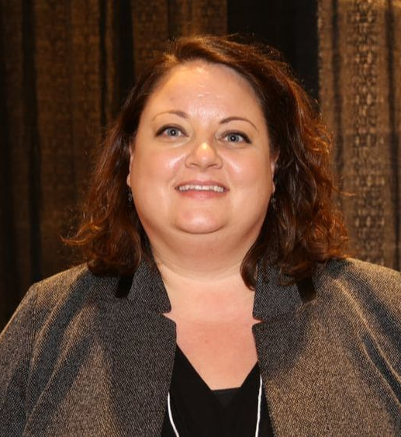
President Elect- Theresa Meinen
Notes:
Absent. No updates.

Slide 18
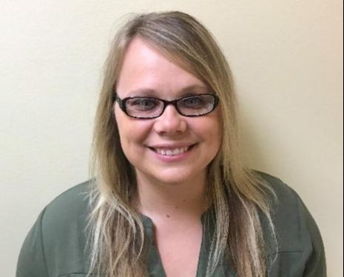
Treasurer Update- Laurel White
Checking Account:
Checking Account (Associated Bank) balance as of August 21, 2023 $69,136.96 Outstanding checks -$6,933.96
$62,203.00
Investments: As of August 21, 2023
Mutual Funds (Edward Jones) $ 103,863.73
Total Assets: $ 166,066.43
Notes:
Laurel White- Updates as shown on slide.
Plan for who can check the mail.
We need to get the key from Ben. Who can volunteer to check the box? Shanna will follow-up to see if she can get the key from him.
1,839.52 for q2 revenue sharing

Slide 19
Treasurer Updates
Donation Raffle (Packer Tickets) was a success!
Investments have not really changed since last meeting.
What is the plan for checking the mail? I think Ben still have the key.
All of the 2023 financial activity can be viewed in the Excel spreadsheet titled
WSRC Quarterly reports 2023
A copy of the 2023 Budget is also attached to the agenda.

Slide 20
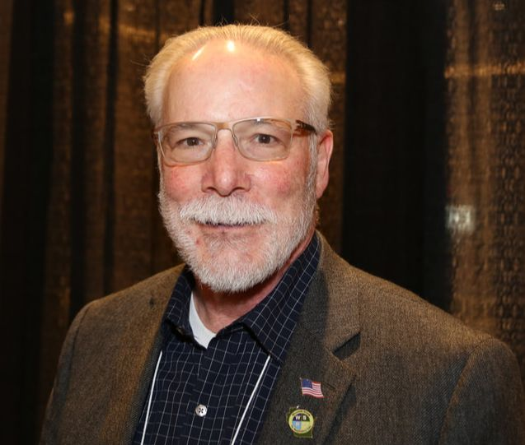
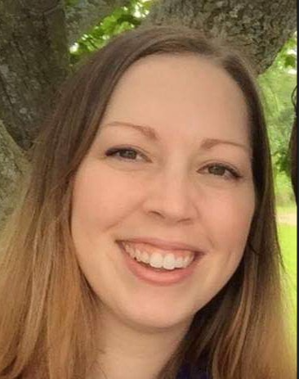
Legislative- Dave Allain, Sarah Bazelak and Kris Ostrander
Assembly Bill 143 and Senate Bill 160
Request removal of Rules and Statues Exam for Respiratory Care Practitioner licensing.
Includes OT, OTA, RPH, APN and LPC licenses.
AB143 heard before Assembly Committee on Licensing Reform
Pulled SB160 from Senate Committee on Licensing, Constitution and Federalism. Strategic Stall because Senate Finance Committee only granted 17.75 new positions to DSPS. Thirteen were temporary. Leg review committee outcome bills were voted down at the May Licensing, Constitution and Federalism Committee.
Notes:
Dave Allain- We had a meeting earlier this afternoon. We are in the process of setting up meetings with congress people in DC. We are looking for someone to contact Dis 7 Tom Tiffany to try to set up a meeting. Sarah Schroeder possibly? We also need someone to reach out for District 8 (Gallagher) to set up a meeting in the Green Bay area.
Jodi Jager has a contact with District 1 – she will send contact info to Dave Allain. Dis 6 Glenn Gropeman- looking for contact person.
We Have not heard anything about virtual lobbying dates
Dustin Goodman- Should we try to do another competition in spring with virtual lobbying?
Charged students with going into the public and doing things highlighting RT and virtual lobbying. AARC sent updates on numbers. Pizza party was given at the end.
Jen Roberts- if held during NRRCC, we did well with WI vs. MN.

Slide 21
Legislative – Dave Allain, Sarah Bazelak and Kris Ostrander
Next Steps
Meeting with Dan Hereth, DSPS 6/11/23
Focus on common ground for removal of rules and statutes exam.
Enforce that removal of the exam does not lower the standard for licensing in WI.
Schools and employers enforce competency.
Several other health care professions do not have to take the exam-equal standards in WI
Pharmacists and Nurses may need to be removed from the bills.
Meet with Governor Evers-To Be Scheduled
Unable to schedule in August. George working on September dates.
Focus on common ground for removal of rules and statutes exam.
Enforce that removal of the exam does not lower the standard for licensing in WI.
Schools and employers enforce competency.
Several other health care professions do not have to take the exam-equal standards in WI

Slide 22
Legislative-Dave Allain, Sarah Bazelak and Kris Ostrander
PACT Days-Washington D.C.
Rebranded as 2023 Annual Respiratory Fly-In
Better clarifies AARC Political Action Committee support
September 26-27, 2023
DoubleTree by Hilton Hotel
Sarah B and Dustin G representing WSRC.

Slide 23
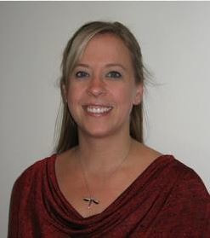
Delegate- Laura Packard Delegate Elect- Dustin Goodman
WSRC Bylaws are due for review by Feb 2024 (submit by Jan). Review at Fall Retreat.
3 Resolutions needing votes for July HOD Meeting – 2 passed at summer HOD, 1 Withdrawn
The big list review.
WSRC recognized in three categories for the Summit Award
Student Liaison \ Representation at National Meetings. | AARC Section Chairs will have a student ambassador
HOSA Partnership
NBRC Update | Exam Changes
Governmental Affairs | ACT Passed, APRT Position,
Notes:
Big List shared by Laura Packard. Sent to Crystal Lockard to include with the minutes. Highlighted important sections.
Dustin Goodman-Bylaws due in Feb, we will work on these during the retreat. Each section chair is adding a student ambassador in 2024. Sponsoring or looking into having a student rep with WI at these meetings. HOSA- working to get into high schools.

Slide 24
Delegate- Laura Packard Delegate Elect- Dustin Goodman
06/23 | Affiliate Toolkits for Revenue Sharing | Discussions about what is needed for the toolkits and further details about it means to be in “good standing” with the AARC. | N/A | October 2023
07/23 | Financial Reporting Resources | Committee Working towards finding and implementing resources to help societies with their tri-annual reporting. | N/A | October 2023
07/23 | PACT Preparation | Working the the PACT and the legislative Chairs to prepare for meeting in DC. | Have contacted my congressional rep. Awaiting a response – upcoming meeting. | August 2023.

Slide 25
Facilities- Laura Packard
FALL RETREAT
Location: La Crosse
Dates: Monday October 2 – Tuesday October 3
Monday – Half workday with Dinner and Team Building Event to follow.
Tuesday – Full workday with Breakfast and Lunch at meeting. District Event.
Wednesday - Safe Travels
Notes:
Laura Packard- Franz Schuttenhelm and Theresa Meinen are working on the agenda. Laura Packard is working on team building event. Please RSVP by the end of the month.

Slide 26
Monday, Oct 2nd – Western TC Campus TBD
1230-1300: Arrive at Western Technical College for the retreat to begin. Parking passes will be shared prior to the retreat.
1300-1400
AARC speaker TBD- Heather Wilden Arranging
1400-1500
Teri Miller AARC VP of Internal Affairs
-HOSA, student involvement, and WSRC student chapter opportunity
1500-1600
BOD discussion on what was just shared:
HOSA and more student involvement/state chapter
How to model our plan with AARC.
Discuss Summit Award items.
1600: Check-in to hotel.
1700-1830: BOD Dinner
1830-2100: BOD Networking Event & Team Building Activity.

Slide 27
Tuesday, Oct 3rd – Western TC Campus TBD
0830-0900: Breakfast provided at Western TC campus
0900-1200: (Check out of hotel prior to meeting. Check out is 11am, but you may be able to request a late checkout of 12. The Radisson can hold baggage if needed.)
Small group work: Transparency, Policies and procedures of roles, gameplans for each role, orientations, etc.
Small group work continued: Social media, membership drives, outreach
Other chairs and roles continue with the previous bullet point items and/or seek other role goals/improvements.
1200-1300: Lunch provided.
1230-1300:
Discuss Board meeting structure based on AARC leadership bootcamp suggestions/presentation.
1300-1400: Guest Speaker/Q&A to help further advance our fundraising
1400-1530 Discuss and finalize RC week plan.
Large group discussion items: Social media ideas, Student involvement, More RT involvement, etc..
Approximately around 1530-1600 BOD meeting
Evening District 6 gathering and dinner- Approximately 1800
Dr. Dareaux Gundersen Health System, Tezspire presentation at the Waterfront restaurant (walking distance from Radisson). All District 6 RTs will be invited to come and meet the board. Thanks to Dr. Mahr for arranging.
Other options: community service

Slide 28
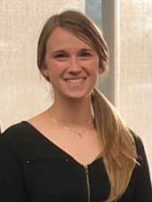
District 1- Megan Ryba
Counties of Douglas, Bayfield, Ashland, Burnette, Washburn, Sawyer, Polk, Barron, Rusk, St. Croix, Dunn, Chippewa, Pierce, Pepin and Eau Claire
Notes:
Updates given by Megan Ryba. July 10th express game approx. 25 people come. Raised $108

Slide 29
District 2- Nick Goldberg
Counties of Iron, Vilas, Price, Oneida, Lincoln, Langlade, Taylor, Marathon, Clark, Wood, Portage, Waupaca, Adams and Waushara
Notes:
No updates.

Slide 30
District 3- Angela Troxell
Counties of Forest, Florence, Marinette, Oconto, Menomonie, Shawano, Door, Outagamie, Brown, Kewaunee, Winnebago, Calumet, Manitowoc, Fond du Lac and Sheboygan
Notes:
Absent. No updates.

Slide 31
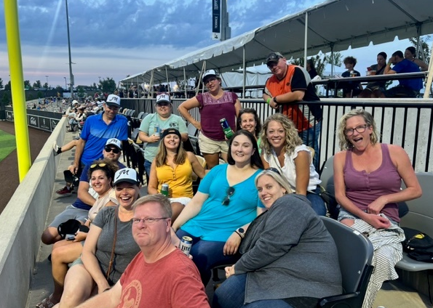
District 4- Shanna Schuele
Student Liaison
Amber Cato- MATC student
Event planning
WSRC Adult symposium
Registration OPEN.
5 CEUs
Social Event
Hosted on August 10th, Milkmen Baseball game
23 tickets purchased
Raised over $100 for scholarship fund.
Counties of Washington, Ozaukee, Waukesha, Milwaukee, Racine and Kenosha
Notes:
Updates given by Shanna Schuele as shown on slide.

Slide 32
District 4 Report
Student Liaison
Amber Cato- MATC student
Event planning
WSRC Adult symposium
Registration OPEN.
5 CEUs
Social Event
Hosted on August 10th, Milkmen Baseball game
23 tickets purchased
Raised over $100 for scholarship fund.
Notes:
Updates given by Shanna Schuele as shown on slide

Slide 33
WSRC Adult Respiratory Care Symposium
Saturday, September 23rd, 2023, 0800-1530
Froedtert Medical Center, 9200 W Wisconsin Ave, Milwaukee, WI.
5 CRCE’s & Breakfast, lunch, refreshments included
Agenda:
0730-750 Registration
0800-0810 Welcome & Housekeeping
0815-0915 Beyond the Surface: Exploring the Use of Lung Ultrasound in Respiratory Care, Tyler Weiss MSc, RRT, RRT-ACCS, AE-C, FCCP
0920-1020 Investing in YOU: Professional Development for Leaders, Dana Evans MHA, RRT, RRT-NPS, FACHE, FAARC
1025- 1125 Identification and Prevention of Extubation Failure in Adults, Ramandeep Kaur, PhD, RRT-ACCS, AE-C
1130-1215 Lunch/ vendor walk through/membership discussion
1215-1230 WSRC Membership benefits
1235-1335 Utilization of High Flow Therapy Across the Continuum of Care, Julie Jackson, BAS, RRT-ACCS, RRT, RCP
1340-1440 Breathing Easy with Acute Asthma Exacerbations, Christopher S. Amato, MD FAAP, FACEP
1445-1455 Thank you & CEU instructions
Registration QR code
Cost: $10 student , AARC members $30, Non-AARC members $40
Registration due by September 1^{st.}
WSRC Adult Respiratory Care Symposium Tickets, Sat, Sep 23, 2023 at 7:30 AM | Eventbrite
Notes:
Updates given by Shanna Schuele as shown on slide

Slide 34
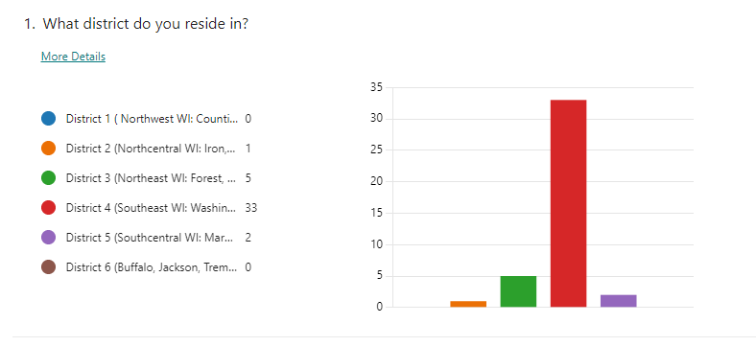
District Survey
Survey released to gain an insight into opportunities for engagement of RTs across WI.
41 responses so far
Shared on social media.
Call for help
Please help share survey (next slide deck)
Notes:
Shanna Schuele- Please continue to share survey to get more people to fill it out. FB likes, shares, etc. will be entered into a drawing.

Slide 35
WSRC Survey
The WSRC remains committed to supporting the needs of respiratory therapy across the state of Wisconsin. To better understand your interest in local WSRC events, we are seeking RT professionals to complete this short survey (5 minutes) to allow us to take a strategic approach to future events and planning. Please complete this survey and share this post with fellow WI RTs. Every survey helps!

Slide 36
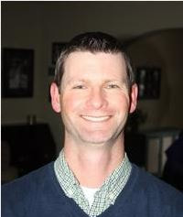
District 5- Joe Punzel
No Current events. Both scheduled events with Aerogen fell through for the summer.
Working recruitment for student AARC memberships with incoming students
Will have a Pints for Practitioners set up for Respiratory Care week
Counties of Marquette, Green Lake, Sauk, Columbia, Dodge, Grant, Iowa, Dane, Jefferson, Lafayette, Green, Rock and Walworth
Notes:
Updates given by Joe Punzel. No updates. /two events cancelled over the summer. May have a student liaison for the upcoming year- waiting on confirmation.

Slide 37
District 6- Melody Kloepfer
Student Liaison
Leann Thao (Western Technical College)
WSRC “chicken que” Fundraiser Thursday, October 19th (pre-RC week)
Western RT Club students will assist with ticket sales and help that day.
Donated meal purchases will be available, so that anyone/anywhere can purchase a ticket and the meal will be donated.
Counties of Buffalo, Jackson, Trempeleau, LaCrosse Monroe, Juneau, Vernon, Richland and Crawford.
Notes:
Updates by Melody Kloepfer as shown on slide.

Slide 38
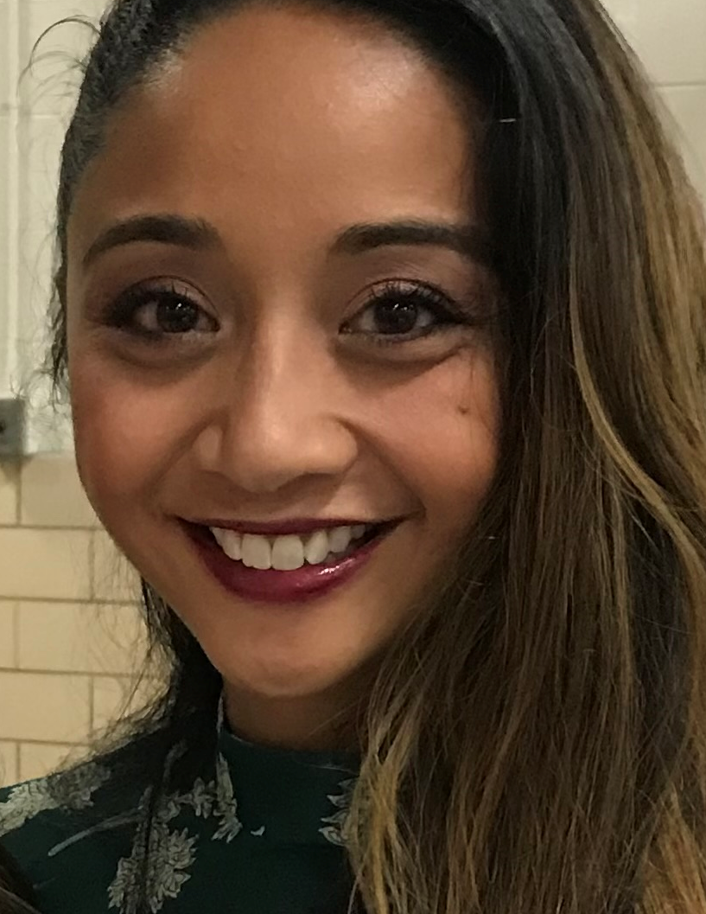
Media Relations- Pia McEleney & Taya Haas
Facebook – 1,114 followers
+31 from last meeting
Engagement +118% in last 90 days
Instagram -222 followers
I am slacking on this :(
District 4 - Adult symposium
Request $ for registration reimbursement
Survey
Currently 20 responses
Give away for like share and comment 3 RT’s?
Linkedin Page up and Running
Any other fun recurring ideas?
Thinking Thursday
Fun fact Friday starting soon
Like, share and comment!
AARC toolkits are being used
Any fun RT week ideas?
Notes:
Updates by Taya Haas as shown on slide.
Bootcamp has some social media ideas in the distributed powerpoint. Franz Schuttenhlem to share with the board.

Slide 39
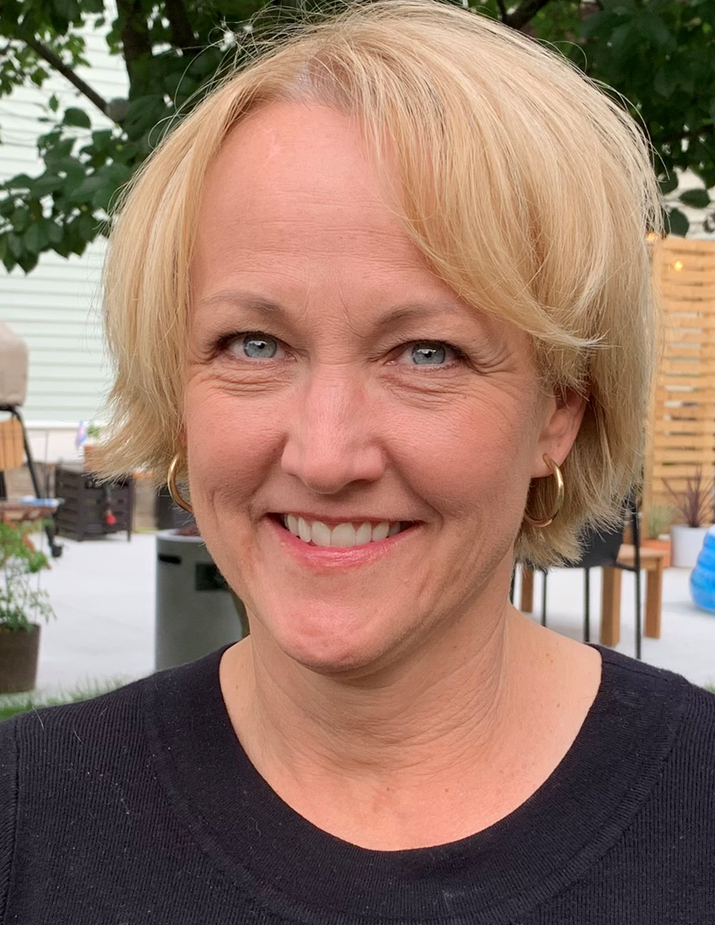
Membership- Kellianne Fleming & Amy Setchell
Notes:
Absent. Membership updates given by Franz Schuttenhelm.

Slide 40
Notes:
Membership updates given by Franz Schuttenhelm.

Slide 41
Notes:
Membership updates given by Franz Schuttenhelm.

Slide 42
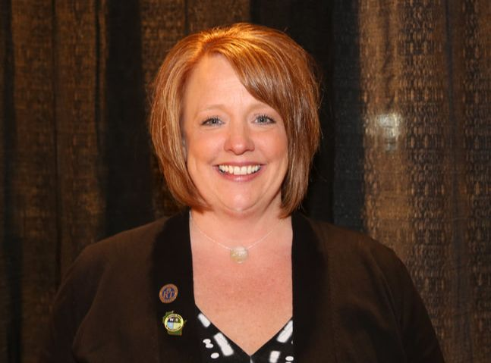
NRRCC- Jen Horkan
Notes:
Updates given by Jen Roberts- We have had two meetings so far for 2024. Just starting to plan. It will be at a new venue- Hilton. Everything will be in one location. Speaker committee is working on collecting speaker ideas and speakers.
Question regarding the sputum bowl – Have we thought about how to do preliminary events prior to the final sputum bowl?
Jen Roberts- it is up to the state society to hold the preliminary event and send the final to conference.
Joe Punzel- virtual may be tough, Madison College would be open to hosting a prelim event.
Jen Roberts & Joe Punzel are willing to help.
Dustin Goodman is also open to hosting at CVTC. It is becoming standard to hold one prelim event and then sending the final group to conference.
Joe Punzel- we already have everything ready to go (questions, etc), we just need a space to hold it. Sunday morning or early afternoon would be the final sputum bowl.
Joe Punzel, Jen Roberts, Franz Schuttenhelm and Dustin Goodman to meet to plan.

Slide 43
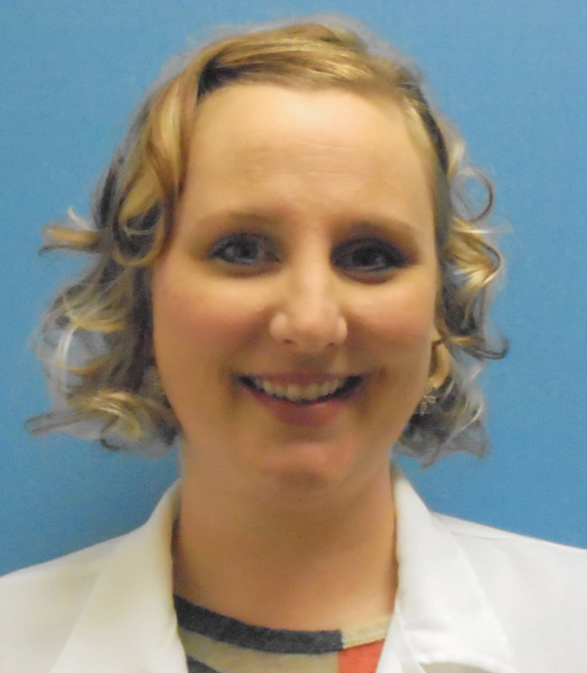
Elections- Sarah Schroeder
Notes:
Sarah Schroeder- The NRRCC is a little earlier this year. We will need to change dates on the timeline in 2024 to give the 60 days to notify any new elected BOD members. Will finalize dates at the retreat.
When voting closes mid February, will need help to verify votes.
Franz Schuttenhelm & Nick Goldberg volunteered to help.

Slide 44
Policy & Bylaws- Brett Buenzli
Notes:
No updates.

Slide 45
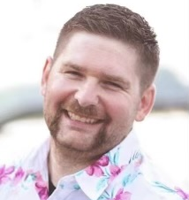
Military Liaison- Jarrett Brandes
Notes:
No updates.

Slide 46
AARC House of Delegates- Jodi Jaeger
Notes:
No updates.

Slide 47
Secretary- Crystal Lockard
Fill out and email reports for those who have not sent/completed them prior to the meeting
Notes:
If you did not send reports prior, please send them to be included in the minutes.

Slide 48
Other Committee Reports or business to discuss?
New Business Discussed and not completed?
Notes:
No new topics.
Franz Schuttenhelm- WSRC is in a good place. We have a stellar state society!

Slide 49
Next Meetings
October 3rd at the conclusion of the WSRC retreat
December 12 1630-1800 (Tuesday)
March 5 1630-1800 (Tuesday)
NRRCC 2024 Sunday, April 21st 1630

Slide 50
Adjournment
Motion?
2nd the motion?
All in favor?
All opposed?
Notes:
Dustin Goodman made a motion to adjourn
Seconded by Ron Pasewald
Motion passed
Adjourned at 6:07pm

