Slide 1
Wisconsin Society for Respiratory Care Board Meeting
NRRCC Board Meeting- June 27, 2023

Slide 2
Roll Call- Quorum
ARTICLE X - BOARD MEETINGS
A meeting of the Board of Directors may be called by the President or the majority of the voting membership of the board.
A majority of voting board members must be present to constitute a quorum. (13 voting members= require 7 for a quorum)
Notes:
Quorum met at 4:30pm

Slide 3
Call to Order-
Notes:
Call to order 4:31pm

Slide 4
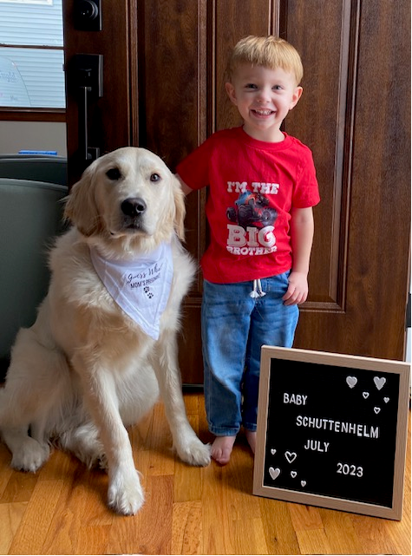
A moment for hyperoxygenation…..
Notes:
Congratulations Franz!!

Slide 5
Becoming a Fit-for-Purpose Association Director - Forum Magazine
Six Reflection Questions
Why do I want to serve on an association board?
Why am I one of the best-prepared people to help make tough decisions?
How do I learn and help others learn?
What does stewardship mean to me?
What is my orientation toward the future?
What sacrifices will you make for the benefit of your successors?
Notes:
Shared by Shana Schuele

Slide 6
Take away points…
You must locate your intrinsic motivation for seeking board service.
We must accept boards are imperfect and will always operate with incomplete knowledge.
Stewardship is the board’s shared commitment to leave the systems for which they are responsible better than how they found them for the benefit of stakeholders and successors.
Boards must do all they can to safeguard their stakeholders and successors from harm throughout this decade and beyond.

Slide 7
Minutes-
Previous Minutes reviewed and approved?
Motion?
2nd the motion?
All in favor?
All opposed?
Notes:
Theresa Meinen made a motion to approve the minutes.
2nd by Laura Packard
Motion passed

Slide 8
Old Business
Updated policies- VOTE (Brett and Franz)
Fundraising committee update (Megan, Theresa, and Franz)
Wisconsin School Counselor Association (WSCA) conference

Slide 9
Policy & Bylaws- Brett Buenzli
Policy revisions sent via email at the NRRCC meeting.
Policy procedure manual
Education Scholarships
Delegates
B&A committee
District Representatives
Facilities
Regulatory
****If rooms are shared for the NRRCC convention, then reimbursement will be for two days instead of one.
Notes:
Prior email with all policy and bylaw edits was sent out 5/31/2023.
Laura Packard made a motion to approve the policies and procedure updates.
Crystal Lockard seconded the motion.
Motion passed.

Slide 10
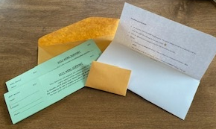
Fundraising committee Theresa, Jen, Megan, Laurel, Franz
Notes:
Ticket donations are in full swing.

Slide 11
Fundraising committee Theresa, Jen, Megan, Laurel, Franz
Donations with ticket stubs continue until August 1st. Paypal donations can continue up until August 15th or so.
Drawing August 17th at noon.
Send receipts/stubs to me:
Franz Schuttenhelm
619 19th Street South
La Crosse, WI 54601
Let me know when you send them so I can make sure I’m getting the mail. So far, I just have Laura P.
Money can be sent to me or Laurel. Best method may be keeping what you’ve received and submitting to Laurel via the paypal account. Just keep us in the loop with communication.
Any other discussion for now.
Just keep selling. ☺
Notes:
Updates given by Franz Schuttenhelm. See slide above.

Slide 12
WSCA conference
Wednesday, Thursday, Friday
November 1st through 3rd, 2023
Kalahari, WI Dells
Exhibit tables range in cost from $400 to $500. Click here to sign up as an exhibitor
Notes:
Updates given by Franz Schuttenhelm. Website does not list clear exhibit table times.

Slide 13
Notes:
Registration information shown above.

Slide 14
Only 3 booths left at green level.
Notes:
Confusion on what green level may mean.
Theresa Meinen made a motion that we send two people to this conference.
Megan Ryba seconded.
Motion passed.
Franz Schuttenhelm will make a sign-up to look at people’s availability to help represent RT at this conference.
Theresa Meinen will work with budget, who we send, registration etc.

Slide 15
New Business in addition to upcoming reports
Non-AARC member fees for WSRC related conferences
Notes:
A question has been raised regarding non-member fees.

Slide 16
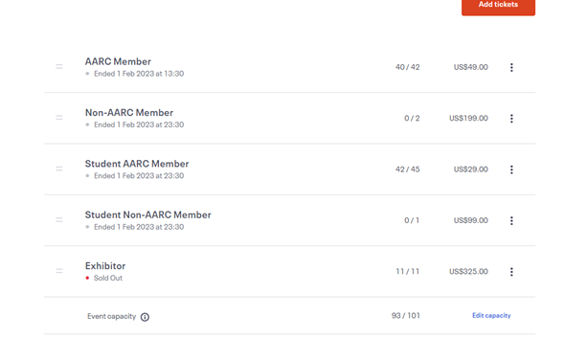
CVTC example
Notes:
Example of past conferences the WSRC has co-sponsored.
Discussion:
See Kellianne slide for her feedback on the district 4 slide.
Laura Packard- We did this on purpose to sign up for the same amount to push them to become a member and attend the conference. Mentioned that some people may not be able to financially afford becoming a member.
Laurel White- If you don’t have the “perks” of discounted rate, the members do not see the value of being a member.
Sarah Bazelak- We have a $10 difference to try to show them the benefits in real time with the WSRC booth. Get them “in the door” and show them what we have to offer.
Shana- Employers used to reimburse for education and that is not always the case anymore. Given the current financial climate, we are really trying to support the RT’s of Wisconsin.
Theresa Meinen- The reason this was done at the direction of AARC HOD meetings and best practices done with other states. This is done to support membership. The direction of the AARC was to charge double the cost of a non-member to show the value of the membership. CVTC has been running this conference since 2006 and we have had no issues with attendance. We have always had people become members at the conference.
Dustin Goodman- Did a search through the AARC, which contains the best practice video and how to push forward with this initiative.
Kris Ostrander- We have the districts and we need to plan the conferences all the same way for consistency. If we made this change, we would need to make sure that AARC is okay with this as well.
Ron Pasewald- We have historically had a lot of discussions about this in the past. It is hard to regulate what a district rep can or cannot spend on a conference event may hinder events rather than benefit the event. We are trying to “dangle a carrot” of a low-cost educational opportunity to show up and work on raising fees in the future. We also need to remember that our WI state licensure does not require CEU’s for our stateuary requirements.
Theresa Meinen- The increased price for a non-member does not have anything to do with a ROI- it is only for membership encouragement. Are we using this as a membership drive and are we going to use our educational events as those means? Or are we purely using this for an educational event? We are looking for two full purposes for these conferences.
Taya Hass- Would we be able to look at a percent increase vs. a set dollar amount cost. I.e. 70% increase in cost. This was not able to found in the policy- should this have it’s own policy?
Theresa Meinen- Our policy is not as clear as it should be.
Dustin Goodman- We need to decide if it is a education/membership or mixture of both. He could not find anything about a specific dollar amount, but can reach out to the AARC to find out if they have a set dollar amount.
Laura Packard- Can we automatically become a member with the higher rate?
Theresa Meinen- Many people have done this at other conferences. As they register as non-members, you could list that this includes a membership.
Shanna Schule- Likes the idea of a percent increase- it shows that being a member is a perk. There is a large amount of RTs who are not WSRC members.
Theresa Meinen- How many CRCE’s are we providing and what relation in cost does that mean? We need to define this policy wise as we plan more around the state.
Laurel White- If we are worried about getting a good turnout- we could lower the member rate even more. If you did pay the higher amount to register and then give them a year long membership. This is hard if the treasurer is not attending because they have probably paid through paypal at the higher rate and would need the credit card there to register, as well as the person as you create an account for the person when you purchase the membership. Would we reimbursement a set amount once they sign up as a membership? We should think about the process behind how this would happen.
Franz Shuttenhelm- Do we give grace and move forward after this conference?
Theresa Meinen- If we leave it that low, RT’s are going to notice that the price is much lower than other conferences that we have done in the past and expect that to come.
Shanna Shuele- This was shared on social media and all members involved have passed it along to schools, co-workers, etc. It would be easier to move the member cost down, but it will be noticed either way.
Laurel White- Agree with Theresa- slightly increase the non-member and decrease the member for this conference and then go by policy moving forward.
Dustin Goodman- Have people registered already? Did you pick the cost for a certain reason?
Shanna- No, only the save the date. No reason for the choosing of the cost, we just got together as a group and picked the numbers.
Dustin Goodman- Proposed leaving the member rate at $40 and charge $100 for the non-member rate to mostly align with the other districts.
Sarah Balazak- We do not have a data point right now to show where we need to go with our current costs. We wanted to target a hourly wage as the conference rate to try to get people in the door. It would be very helpful moving forward to have that policy to follow and agreed that it should be set upon CEU’s available and be a percentage above the member rate.
Kris Ostrander- We need to remember that we are a sub-committee of the AARC and we need to find out how to align with them. We need to remember that we need to support those that are members by paying for things we need such as the lobbyist to support our membership.
Laura Packard- It already went out and it may look bad on us as a society. Proposes that we touch base with Jodi Jager, our AARC director at large.
Theresa Meinen- We do need some sort of conclusion- Proposed that we change this to a membership drive along with this lower rate and see how many members we get signed up. We do need to move forward with the policy, but we could use this as a trial for a membership drive.
Dustin Goodman- Has to be a conference that the vendor is at and not a “vendor sponsored event” to follow AARC guidelines. I agree with Theresa’s idea that this is a vendor event.
Theresa Meinen made a motion that we leave the cost as is and re-brand the event as a educational event and membership drive.
Dustin Goodman seconded.
Motion passed.

Slide 17
Other reports, updates, and/or new business
President
Vice President
President-Elect
Treasurer
Legislative
Delegates
Facilities
Membership Chairs
Districts
Media Relations
NRRCC
Education
Elections
Military Liaison
AARC Jodi J.
Secretary

Slide 18
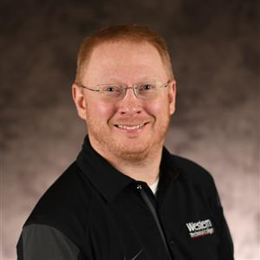
President- Franz Schuttenhelm
NRRCC booth digital response minimal and nothing much to note.
Supporting Legislative Team-
Secretary Hereth meeting in Madison on July 11th.
Fundraising Chair-
Arranging donation drawing material with Laurel’s help.
Working with Theresa on yearly “to do list” calendar for Presidents. This should also be able to expand to all board members.
Completing Summit Award application with Theresa. We’re finalizing this for the 6/30 due date.
Assisting Theresa with the new website.
I’m welcoming Theresa’s support as we try to get Microsoft Business Basic/Teams squared away.
In the meantime- We’ll share this link that should be accessible to see the files.
https://wisocietyrespcare.sharepoint.com/sites/WSRCBoardofDirectors
District Representative and New Board Member orientation guides- via Teams
Some late registrations were allowed full reimbursement. We’ll make sure to remind everyone to sign up for early bird registration next year, as that is what is reimbursed by the WSRC.
Notes:
Updates given as Franz Schuttenhelm. See slide above.

Slide 19
Website items
Home Page:
Description of AARC role as a chartered affiliate
Mission and Vision
Running membership tally
Elite Sponsorship (1)
Advertising to sponsor with us link.
About Us:
BOD members, District locations, Bylaws & Policies, Contact Us, Meeting Minutes, Approved Budgets
Resources:
General AARC items
Education, Employment, Legislation, Students, Recruitment
Advertising opportunities
Events:
NRRCC
Board meeting dates and links for joining.
RTs in the community
Membership information:
Drive information and AARC related links
Our united WI RT Family:
Cheese Wedges for donations
Award history
Notes:
Updates for website items shows above. Theresa did add a folder to teams for the website. We do still need to figure out our advertising plan.

Slide 20
AARC BOOTCAMP
Hello! This is a quick reminder that Leadership Boot Camp registration is open and going strong.
Leadership Boot Camp will be held virtually via Zoom on August 15 and 16, 1 - 4:30 p.m. CENTRAL each day. The event is free and open to House and Affiliate officers.
Register Now
Thanks!
--Heather
FEEDBACK FROM WSRC BOOTH
Hello! Leadership Boot Camp 2023 is coming this summer. Mark your calendars for August 15 & 16 (1 - 4:30 p.m. CENTRAL each day). Leadership Boot Camp will be held virtually via Zoom; stay tuned for agenda details and the registration link. We look forward to meeting with you all (and affiliate board members). This event is free for HOD and Affiliate Officers and Delegates. Thanks! --Heather
------------------------------ Heather Willden Director of Governance and Strategic Initiatives HOD Liaison
Notes:
Bootcamp is coming back! See slide above for information. No limits found on attendance.

Slide 21
Vice President- Ron Pasewald
WSRC District 4 Educational Symposium
Assisting Sarah B and Kellianne with planning
Looped new District Rep (Shanna) in June 2023
Save the date going out soon (Sept 2023)
National RT Compact Licensing
Created Educational video - going to membership July 2023
Created Compact Survey – going to AARC Connect HOD_Pres after Summer Forum (July 2023)
Completed grant application (June 15, 2023) to the DOD to fund Compact License assistance from the The Council of State Governments
The U.S. Department of Defense (DoD) is providing funding to The Council of State Governments (CSG) to assist professions in the development of new interstate compacts for occupational licensure portability. The scope of this assistance includes the drafting of model interstate compact legislation, developing a legislative resource kit and convening a meeting of state policymakers to introduce the compact.
Planning multiple career fair presentations around Waukesha and Milwaukee counties.
Notes:
Updates given by Ron Pasewald as shown on slide above.

Slide 22
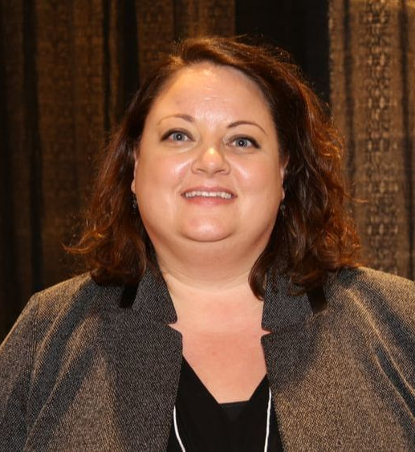
President Elect- Theresa Meinen
Help lead the new website creation.
Continue to assist Fundraising committee and assist creation of this being a permanent committee w/ bylaw specific items.
WSRC board_report_2023-24_Meinen_President Elect.docx
Notes:
Updates given by Theresa Meinen as shown above.
Theresa did post the link in the chat to our website- please bookmark. We do need to move the google drive documents over to merge all information/documents. Crystal & Theresa to work on this.
Moving forward- We need to create a task list to keep the to-do and who complete it, etc. Crystal & Theresa to work on this.

Slide 23
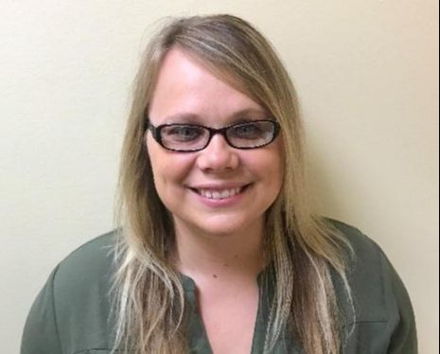
Treasurer Update- Laurel White
Checking Account:
Checking Account (Associated Bank) balance as of June 27, 2023 $106,330.86 (Before NRRCC split holding MN portion)
Outstanding checks -$8,270.47
$98,060.39
Investments: As of June 27, 2023
Mutual Funds (Edward Jones) $ 103,700.76
Total Assets: $ 201,761.15
Notes:
Updated given by Laurel White.
NRRCC split
MN portion $28,030.35
Updated balance in checking 70,030.04

Slide 24
Treasurer Updates
Just closed book for 2023 NRRCC, still need to issue MN their cut, will be taking on the books for 2024 NRRCC in MN
Investments increases $1,730.45 since last meeting
2022 Taxes signed & submitted
All of the 2023 financial activity can be viewed in the Excel spreadsheet titled
WSRC Quarterly reports 2023.
A copy of the 2023 Budget is also attached to below
WSRC-BOD ReportTreasurer 6-27-2023.doc
WSRC 2023 Budget.xls
WSRC Quarterly Report 2023.xls
Notes:
Updates given by Laurel White as shown on slide above. Laurel will work on getting historical budget, etc. onto the new sharepoint page.
Franz Schuttenhelm- Budget and minute approvals should be available for viewing on our website.

Slide 25
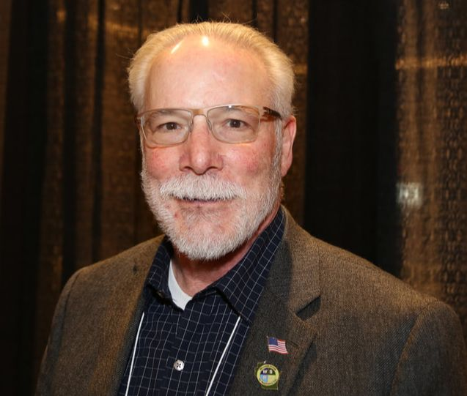
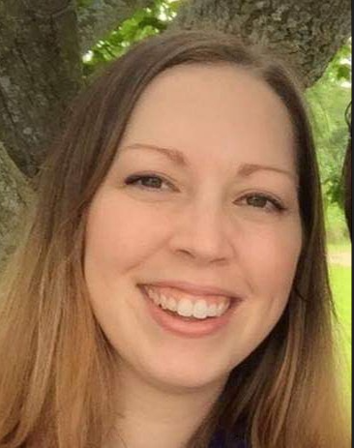
Legislative- Dave Allain, Sarah Bazelak and Kris Ostrander
Assembly Bill 143 and Senate Bill 160
Request removal of Rules and Statues Exam for Respiratory Care Practitioner licensing.
Includes OT, OTA, RPH, APN and LPC licenses.
AB143 heard before Assembly Committee on Licensing Reform
Pulled SB160 from Senate Committee on Licensing, Constitution and Federalism. Strategic Stall because Senate Finance Committee only granted 17.75 new positions to DSPS. Thirteen were temporary. Leg review committee outcome bills were voted down at the May Licensing, Constitution and Federalism Committee.
Notes:
Updates given by Kris Ostrander as shown above.
Sarah has joined Dave & Kris on the legislative committee. Welcome!

Slide 26
Legislative – Dave Allain, Sarah Bazelak and Kris Ostrander
Next Steps
Meeting with Dan Hereth, DSPS 7/11/23
Focus on common ground for removal of rules and statutes exam.
Enforce that removal of the exam does not lower the standard for licensing in WI.
Schools and employers enforce competency.
Several other health care professions do not have to take the exam-equal standards in WI
Meet with Governor Evers
Focus on common ground for removal of rules and statutes exam.
Enforce that removal of the exam does not lower the standard for licensing in WI.
Schools and employers enforce competency.
Several other health care professions do not have to take the exam-equal standards in WI
Notes:
Updates given by Kris Ostrander as shown above.

Slide 27
Legislative-Dave Allain, Sarah Bazelak and Kris Ostrander
PACT Days-Washington D.C.
September 25-26, 2023
Hilton Hotel
Sarah B and Dustin G (tentative) representing WSRC.
Notes:
Updates given by Kris Ostrander as shown above.

Slide 28
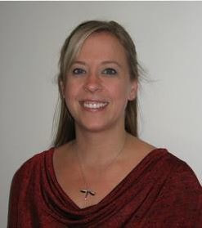
Delegate- Laura Packard Delegate Elect- Dustin Goodman
2023-resolutions-Burk.pdf
2023-resolutions-Hodge.pdf
July 2023 Resolution - Varcelotti.pdf
Delegates Report June 2023.docx
WSRC Bylaws are due for review by Feb 2024 (submit by Jan). Review at Fall Retreat.
HOD Summer Meeting Coming Up – 7/18 & 7/19 in Fort Lauderdale
3 Resolutions needing votes for July HOD Meeting
Notes:
Resolutions that we need to vote on were sent out by email by Crystal Lockard earlier this week.
#1- AARC finds a 3rd party that we as affiliates can use to help with website services.
Theresa Meinen makes a motion to approve the resolution.
Franz Schuttenhelm seconded the motion
Motion passed
#2- A resolution to resolve that the AARC donates $15,000 to Bill Wetzen endowment fund because they have not been able to fulfill it on their own with fundraising efforts to equal $50,000.
This fund does not have a clear use once the fund is endowed- the description is very vague. This should be one of our questions we ask at HOD.
No motion moved forward.
#3- Position statement to create a curriculum in all levels of educational offerings in regards to research, evidence based medicine and quality improvement.
CoARC already gives a list of curriculum for our programs, but what is the purpose of the AARC statement? AARC has no control over the curriculum. Education comes from NBRC and CoARC.
No motion brought forward.

Slide 29
Facilities- Laura Packard
Fall Retreat Location: La Crosse
Dates: Monday October 2 – Tuesday October 3 Monday – Half workday with Dinner and Team Building Event to follow. Tuesday – Full workday with Breakfast and Lunch at meeting. Potential Casual Dinner? District Event? Meet the Board Social? Wednesday - Safe Travels
Notes:
Updates given by Laura Packard as shown on slide above.

Slide 30
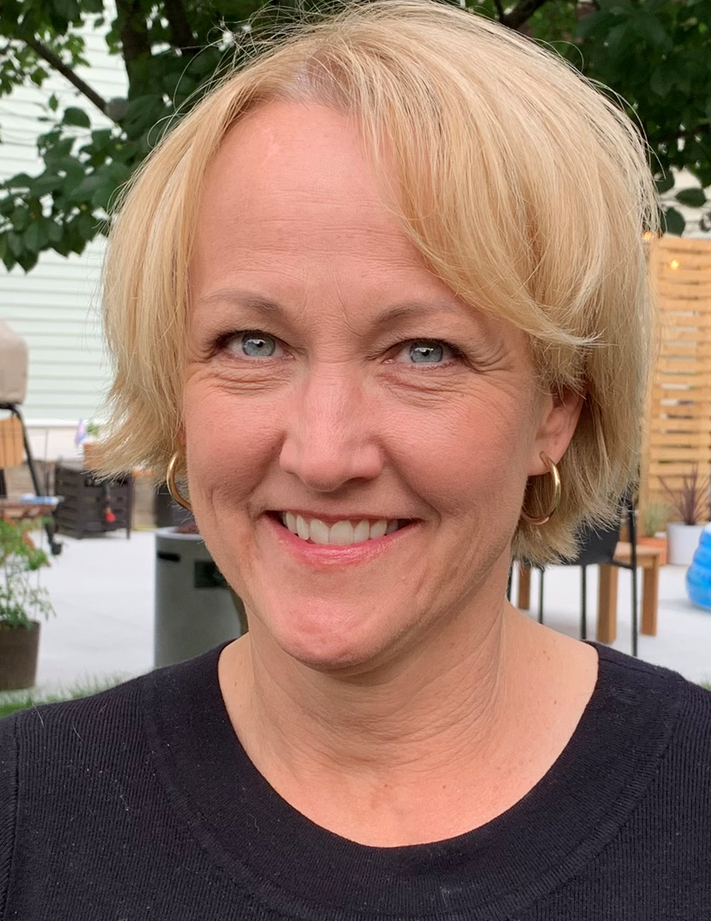
Membership- Kellianne Fleming & Amy Setchell
Emailed questions to the AARC- awaiting replies
Can the state society use the email addresses associated with the member? It would be great to email members district or state opportunities and announcements including reminders to renew.
The lapsed list of members, how often is that list updated? 1st of each month or the actual date the member expires?
How long to lapsed members stay on the list?
Is there a master list of members that do not renew?
Notes:
Updates given by Franz Schuttehelm as shown above.

Slide 31
Notes:
Updates on membership given by Franz Schuttenhelm. See slide above.

Slide 33
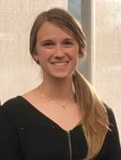
District 1- Megan Ryba
⚾️⚾️Don’t forget to get your tickets BY JULY 5TH for the District 1 WRSC baseball game happening July 10th at 6:35 PM!⚾️⚾️⚾️
Text Megan Ryba - District 1 Representative at 715-579-6020 to purchase tickets before it’s too late!
MY District Representative Report ongoing.docx
Counties of Douglas, Bayfield, Ashland, Burnette, Washburn, Sawyer, Polk, Barron, Rusk, St. Croix, Dunn, Chippewa, Pierce, Pepin and Eau Claire
Notes:
Updates given by Megan Ryba as shown on slide above.

Slide 34
District 2- Nick Goldberg
Counties of Iron, Vilas, Price, Oneida, Lincoln, Langlade, Taylor, Marathon, Clark, Wood, Portage, Waupaca, Adams and Waushara
Notes:
Nick Goldberg absent- no updates reported.

Slide 35
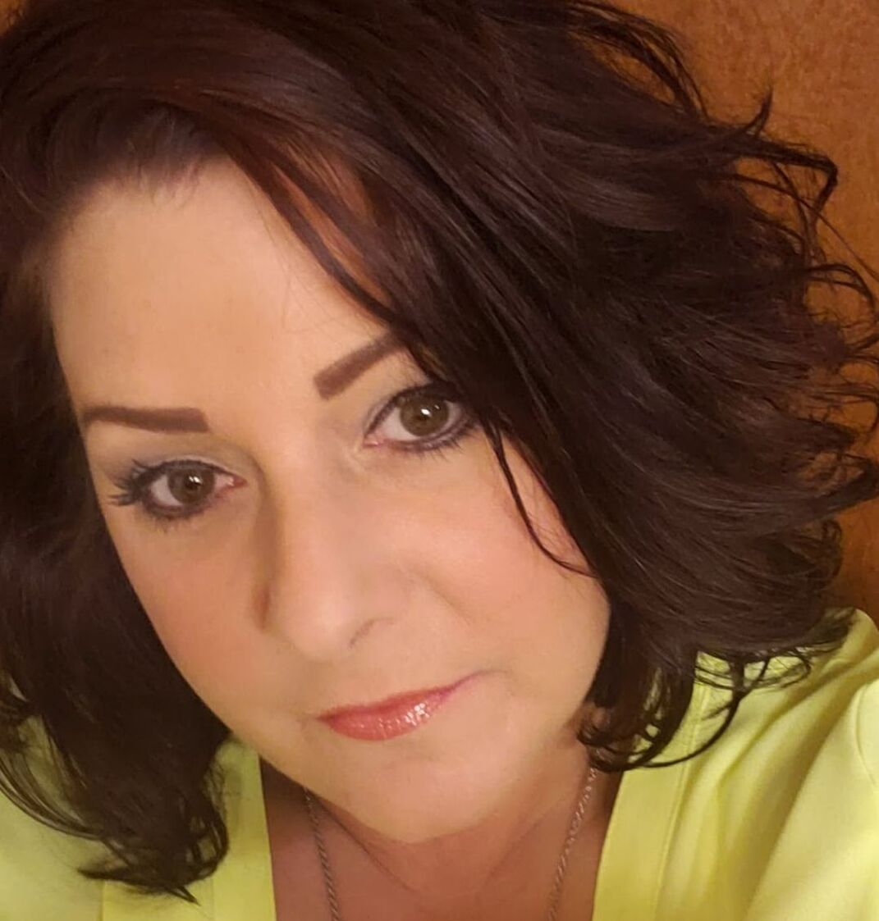
District 3- Angela Troxell
Counties of Forest, Florence, Marinette, Oconto, Menomonie, Shawano, Door, Outagamie, Brown, Kewaunee, Winnebago, Calumet, Manitowoc, Fond du Lac and Sheboygan
Notes:
Angela Troxell absent- no updates reported.

Slide 36
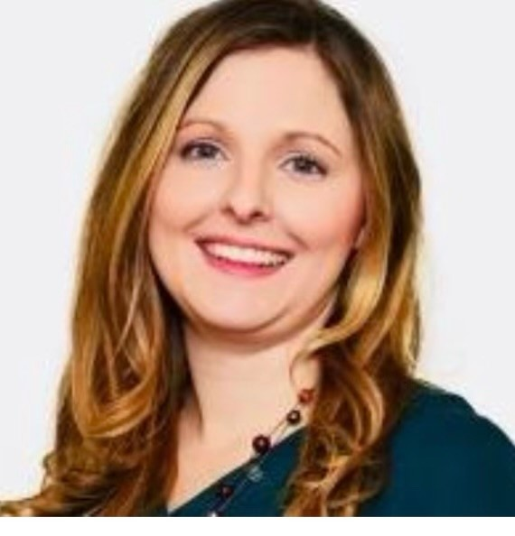
District 4- Shanna Schuele Student liaison/understudy- Amber Cato
Counties of Washington, Ozaukee, Waukesha, Milwaukee, Racine and Kenosha
Notes:
Welcome to Amber- our new district 4 student liaison. She is going into her 2nd year at MATC.
For Discussion: Kellianne’s email 6/27/2023
Hi Franz,
I will not be on the call today, but did want to share my thoughts on fees associated with conferences. Although I understand the math behind the suggested fee of >$129, engagement and educational opportunity for respiratory therapists is our priority, fundraising is secondary. As we are recruiting vendors and pro-bono speakers, volunteering our time and providing a venue, it is important to those of us doing this work that we optimize our opportunity for attendance. I feel the suggested fee of >$129 for non-WSRC members would be a barrier to attendance.
As the event host I recommend fees stay as initially proposed.
Thank you.
Kellianne

Slide 37
District 4 Report
Student Liaison
Amber Cato- MATC student
Event planning
WSRC Adult symposium
Save the date released.
Registration information to come soon.
Thank you, Sarah Bazelak & Kellianne Fleming for starting the work for this!
Social Event
Milkmen Baseball game planning (Franklin, WI). Likely August 10th.
Information to come very soon!
Notes:
Updates given by Shana Schuele as shown on slide above.

Slide 38
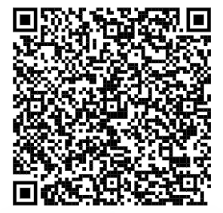
Join the WSRC district 4 for a night at the ballpark
supporting the Milwaukee Milkmen!
Franklin Field 7035 S. Ballpark Drive Franklin, Wisconsin 53132
$20 per ticket (ticket for terrace level, Milkmen gift, hot dog, and soda. Small amount of proceeds will go back to WSRC fundraising efforts.
Use link or QR code to purchase tickets!
Milkmen vs. KC Monarchs - Wisconsin Society for Respiratory Care (fevo.com)
Reach out to Shanna.Schuele@aah.org with any questions.
Notes:
Updates for Milkmen game given by Shana Schuele as shown on slide above. $5-7 will be given back to the WSRC.

Slide 39
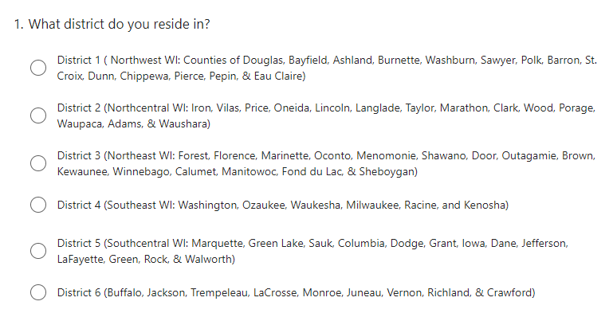
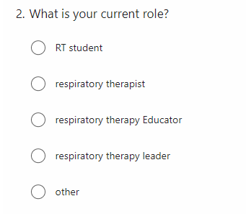
District Survey
Development of survey to identify what RTs in the community want/need from WSRC for events
Notes:
Survey idea on this slide and follow slides. 10 questions in total to help guide district reps with planning events.

Slide 40
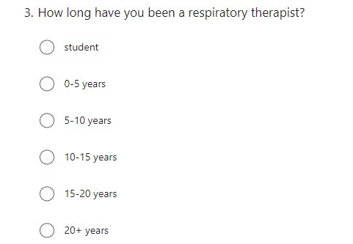
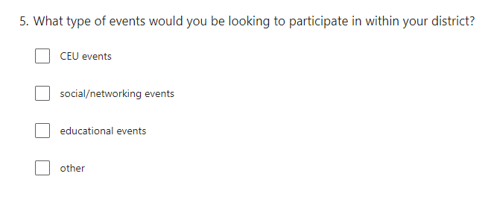
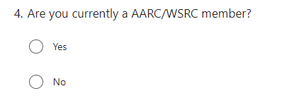
Notes:
Sarah Bazelak: (#4) It would be great to gain insight into what are the barriers if they are not an AARC member.
Theresa Meinen: (#5) Can we add patient education events and events promoting the profession to the options. Shana to add.
Franz Schuttenhelm: (#5) Can we also add volunteering events as an option. Shana to add.
Taya Hass- we could post this on facebook and if they like/share/etc. they could be entered for a free membership.

Slide 41
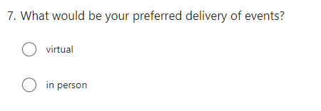
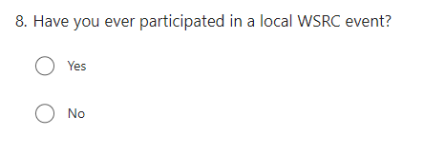

Slide 42
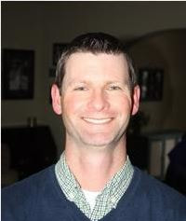
District 5- Joe Punzel Student liaison/understudy-
Counties of Marquette, Green Lake, Sauk, Columbia, Dodge, Grant, Iowa, Dane, Jefferson, LaFayette, Green, Rock and Walworth
Notes:
Joe Punzel absent- no updates reported.

Slide 43
District 6- Open Position Student liaison/understudy- Leann Thao (Western Technical College)
WSRC “chicken que” Wednesday, October 19th (pre-RC week)
Western RT Club students will assist with ticket sales and help that day.
Donated meal purchases will be available, so that anyone/anywhere can purchase a ticket and the meal will be donated.
Continued recruitment for representative. ☹
Counties of Buffalo, Jackson, Trempeleau, LaCrosse Monroe, Juneau, Vernon, Richland and Crawford.
Notes:
Updates given by Franz Schuttenhelm.

Slide 44
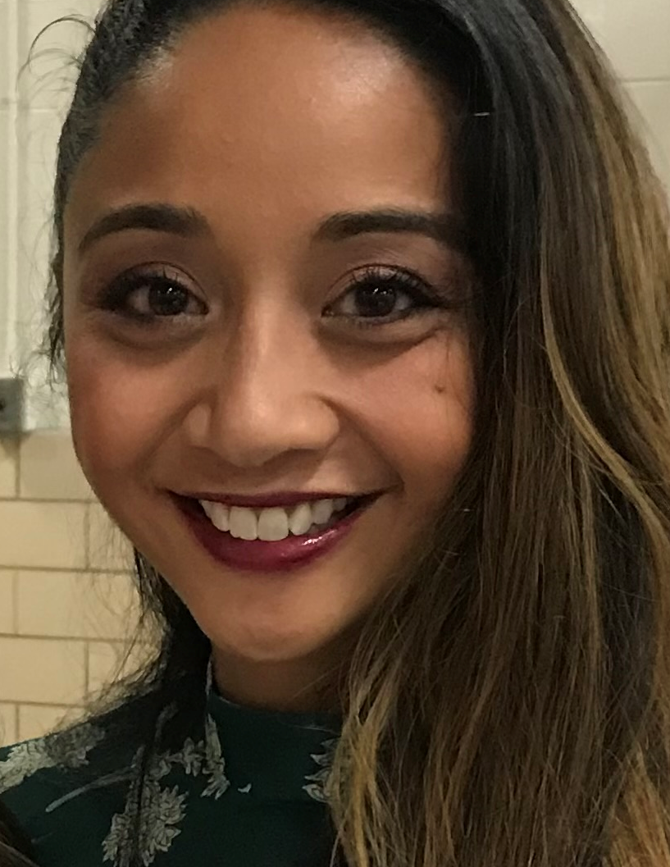
Media Relations- Pia McEleney & Taya Haas
Facebook – 1083 followers
Engagement +111%
Followers +143%
District 1 -Baseball game
District 4 -Save the date repost
Thinking Thursdays
Packer Tickets
How many tickets left??
Any other fun recurring ideas?
Make sure to invite all RTs to our page!
Like, share comment!
AARC toolkits are being used
Notes:
Updates given by Taya Hass as shown on slide above.
AARC Bylaws is strict on what we can/cannot post. Franz will help Taya get in touch with Heather at AARC.

Slide 45
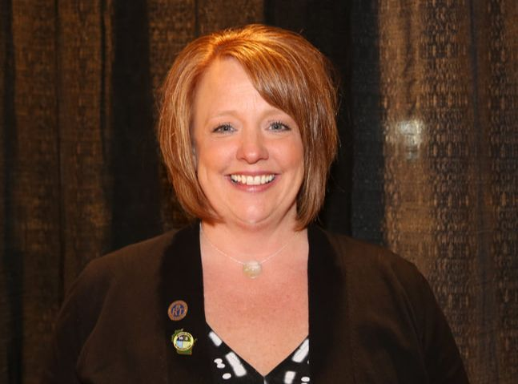
NRRCC- Jen Horkan
NRRCC Conference a great success
Income was $145,641.25,
Expenses were $71,690.06
Profit of $70,951.46- to be divided with Minnesota
We had 80 exhibitors, 96 students, 210 1 and 2 day registrants, 3 spouses and 79 reps
Still concerns with people attending who did not pay at all or who are there on a day they didn’t pay for. This is a concern for liability reasons. Looking at putting more monitoring into place to ensure only paid attendees are participating.
BOD presence needed in exhibitor hall- per exhibitors.
Notes:
Updates given by Jen Horkan. We are signing our MN/WI state contract on the odd years. We will also need to decide how long we want to continue to host the NRRCC in a joint venture with the NRRCC.

Slide 46
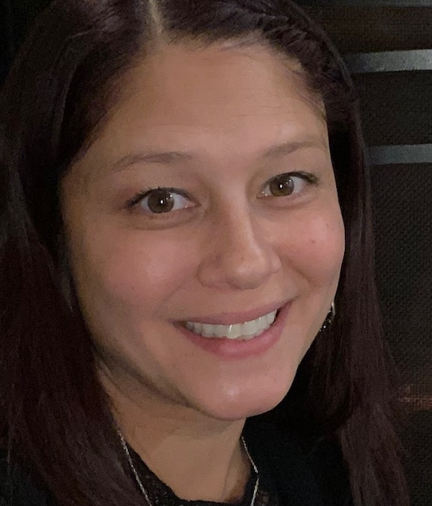
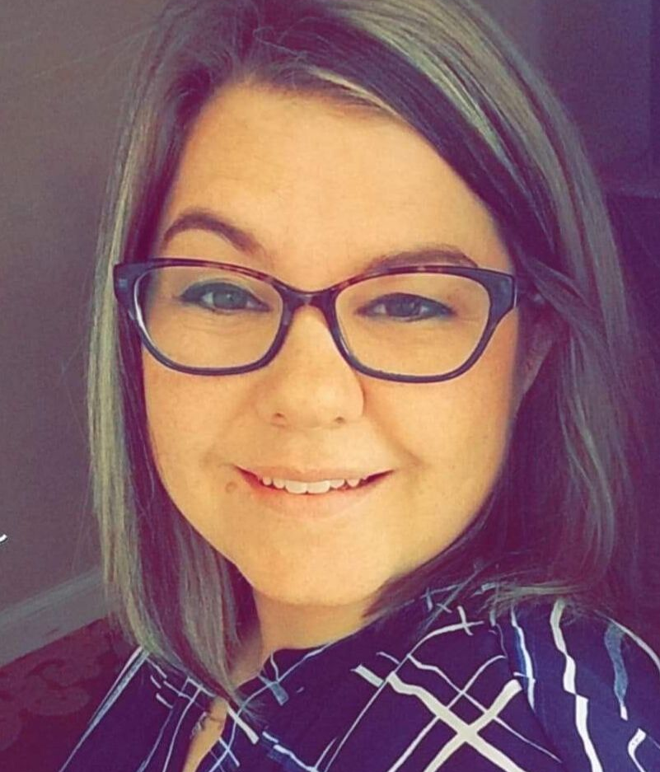
Education Co-Chairs Tara Managan & Christina Pano
NRRCC informal gathering of WTCS instructors.
Notes:
Absent- no updates reported.

Slide 47
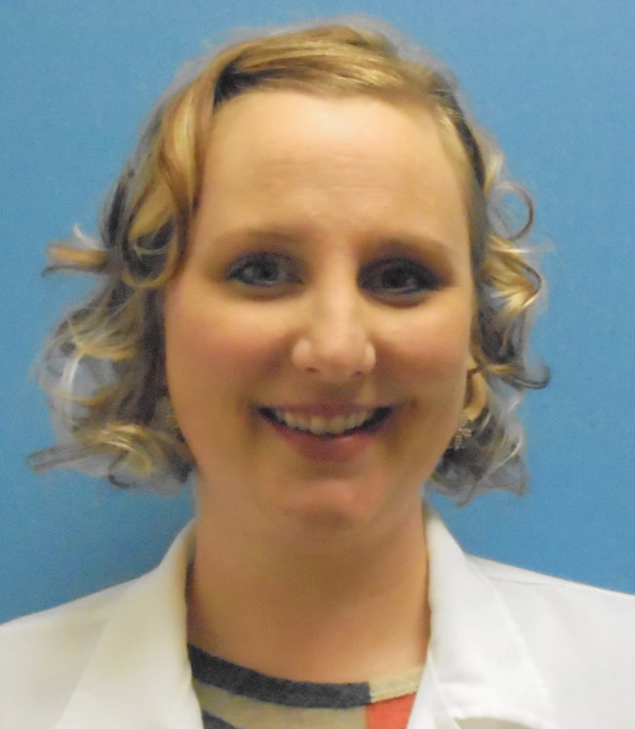
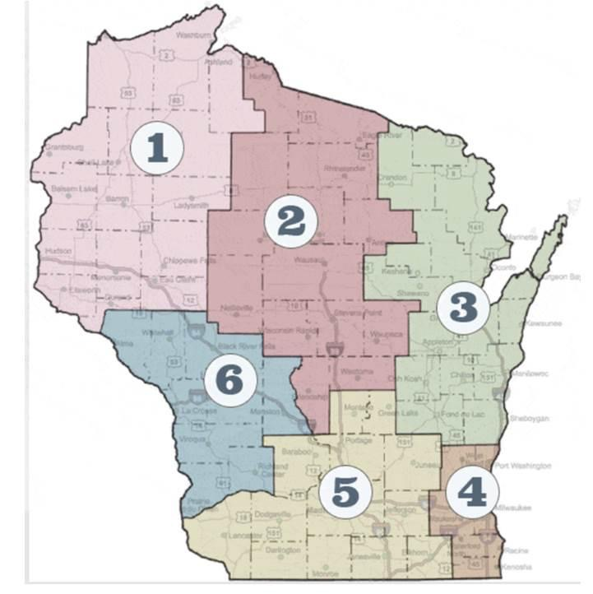
Elections- Sarah Schroeder
District 6 remains vacant.
Notes:
Absent- no updates reported.

Slide 48
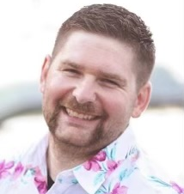
Military Liaison- Jarrett Brandes
Obtained and storing color guard flags and stands from Dave.
Notes:
Absent- no updates reported.

Slide 49
AARC House of Delegates- Jodi Jaeger
Notes:
Absent- no updates reported.

Slide 50
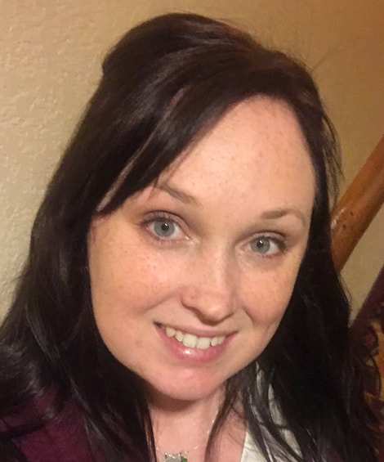
Secretary- Crystal Ley
Fill out and email reports for those who have not sent/completed them prior to the meeting
Notes:
If you did not send reports prior, please send them to be included in the minutes.

Slide 51
Other Committee Reports or business to discuss?
New Business Discussed and not completed?
Notes:
No new topics.

Slide 52
Next Meetings
August 22 1630-1800 (Tuesday)
October 3rd at the conclusion of the WSRC retreat
December 12 1630-1800 (Tuesday)
March 5 1630-1800 (Tuesday)
NRRCC 2024 Sunday, April 21st 1630
Notes:
To do list:
Reaching out about guidance counselor conference (Theresa, Franz)
Website ideas (Theresa)
Rep to create concrete policies regarding events (All district reps & education chairs)
NRRCC final split and explanation of how funds are divided (Jen Horkan)
Google drive to SharePoint (Theresa, Crystal & Dustin)
Social Media Guidelines question to AARC (Taya & Franz)
Edit District Event Survey (Shana)
Distribute District Event Survey when updated (All)
Take questions to HOD about resolutions 2 & 3 (Dustin & Laura)

Slide 53
Adjournment
Motion?
2nd the motion?
All in favor?
All opposed?
Notes:
Theresa Meinen made a motion to adjourn
Dustin Goodman 2nd
Motion passed
Adjourned at 6:28pm

Slide 54
Delegates

Slide 55
B&A

Slide 56
Facilities
WSRC Facilities Chair
The WSRC Facilities chair is appointed to two (2) year term by the board of directors and responsible for the following:
Assisting the BOD / President in making hotel and convention center contracts,
Assisting with on-site management of the fall networking event,
Arranging for audio-visual equipment,
Ordering posters, pamphlets, or postcards as directed by BOD, as needed,
Making arrangements for a contractor to do meeting registrations, as needed,
Arranging for the BOD retreat activities with the WI president
Member of WI budget and audit committee with active participation.
Other duties related to facilities as requested by BOD

Slide 57
District Representatives

Slide 58
Regulatory Committee

